Slide 1


Slide 2
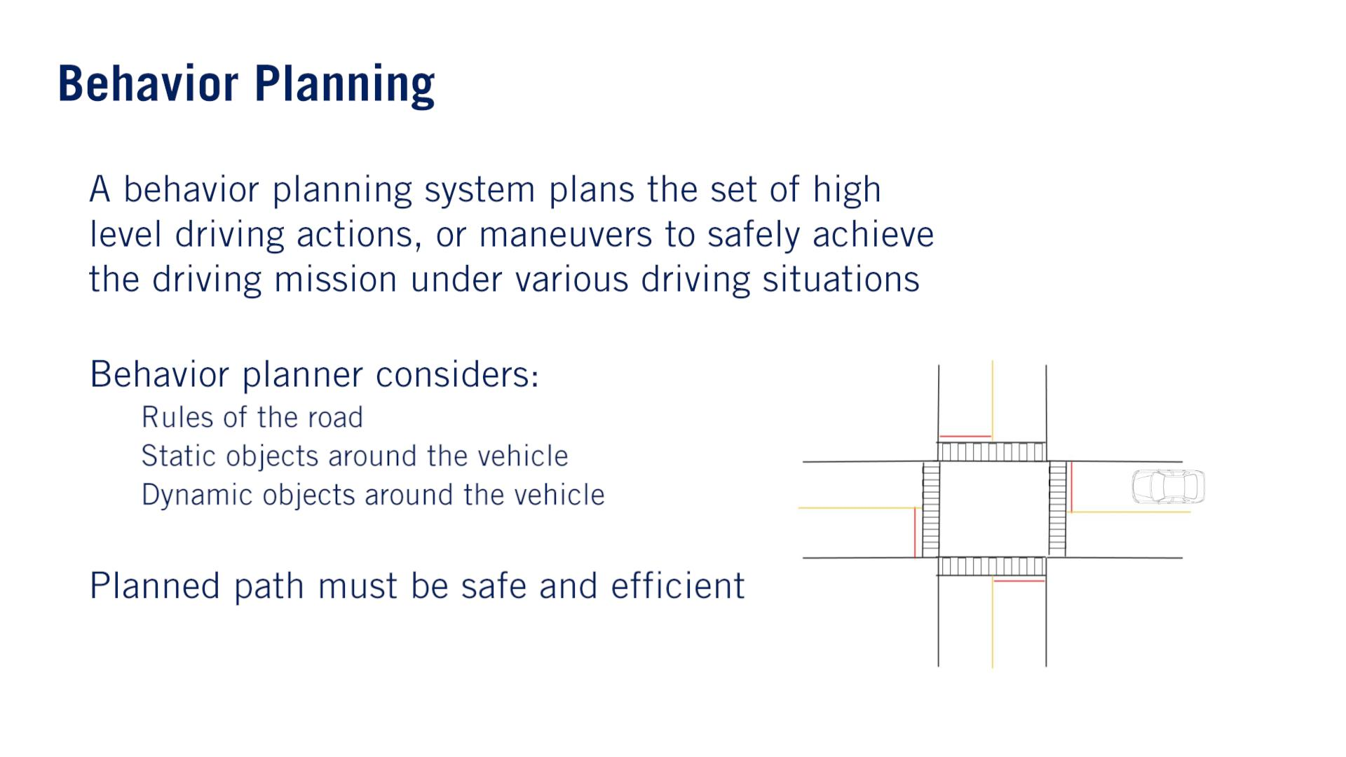
•
•
o
o
o
•
The behavior planners should also be able to deal with inputs that are both inaccurate, corrupted by measurement noise, and incorrect, affected by perception errors such as false positive detections and false negative detections.

Slide 3
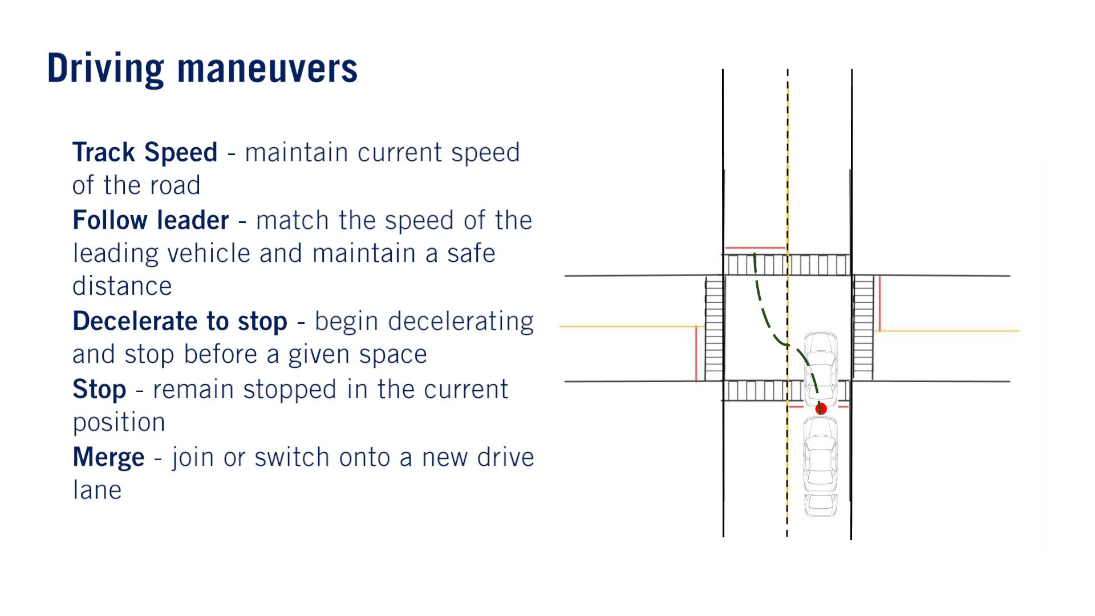
•
•
•
•
•

Slide 4
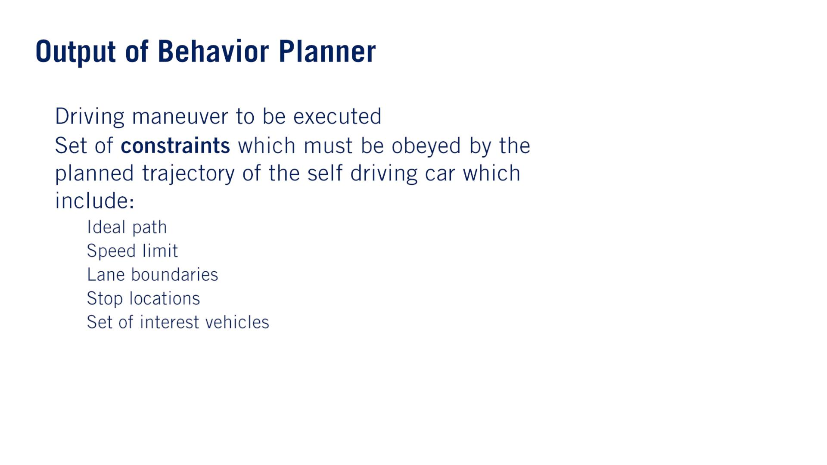
•
•
Constrain the local planning problem.
o
o
o
o
o
These dynamic objects may be important due to proximity or estimated future path.

Slide 5
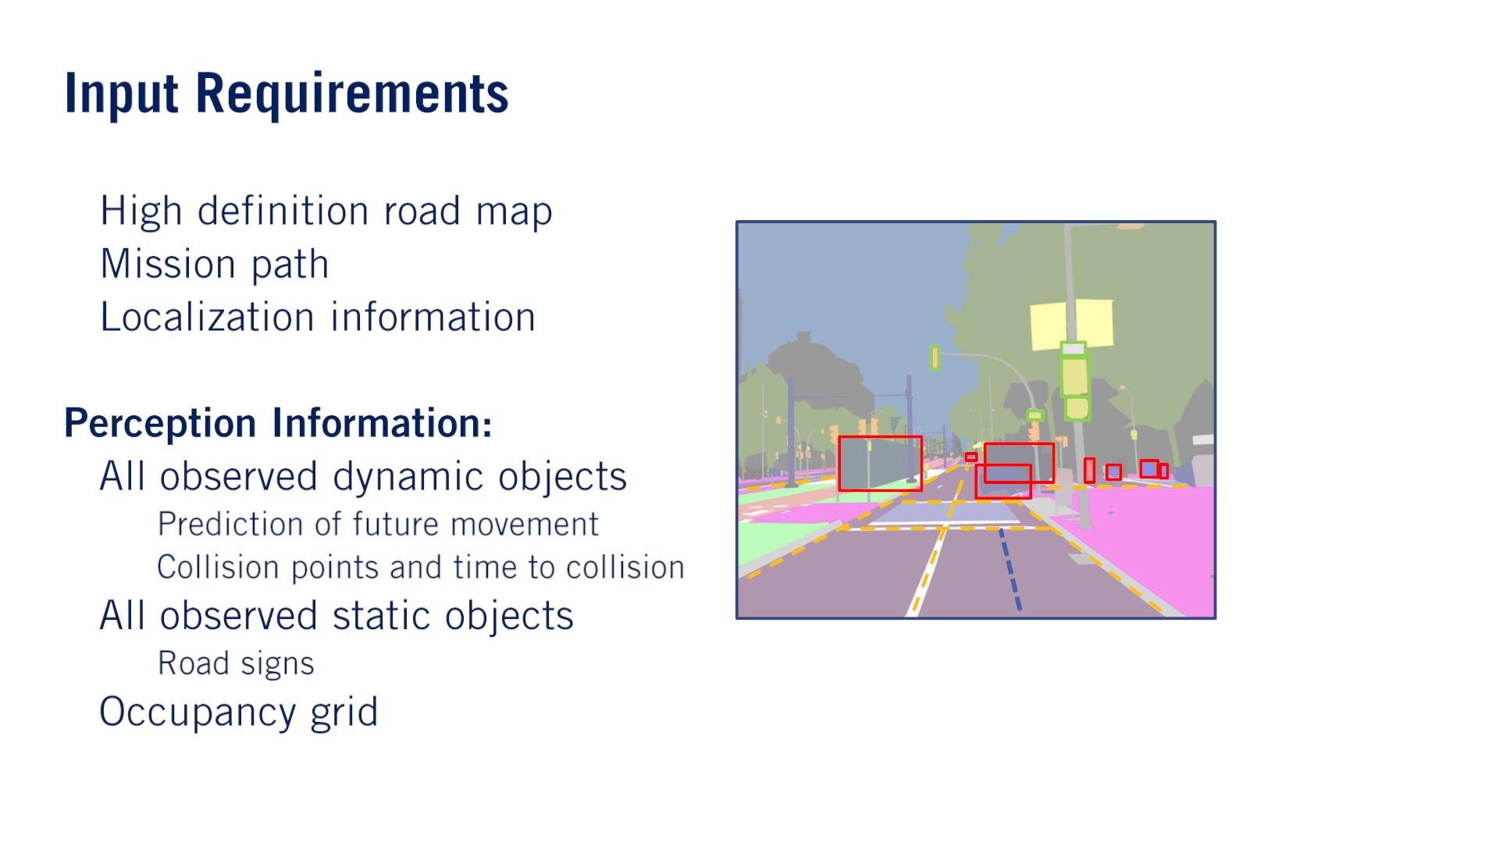
•
•
•
Dijkstra, A*, road network.
•
o
o
•
•
o
parked vehicles. construction cones（ロードコーン）. traffic lights (with an indication of their state).
defining the safe areas to execute maneuvers.

Slide 6
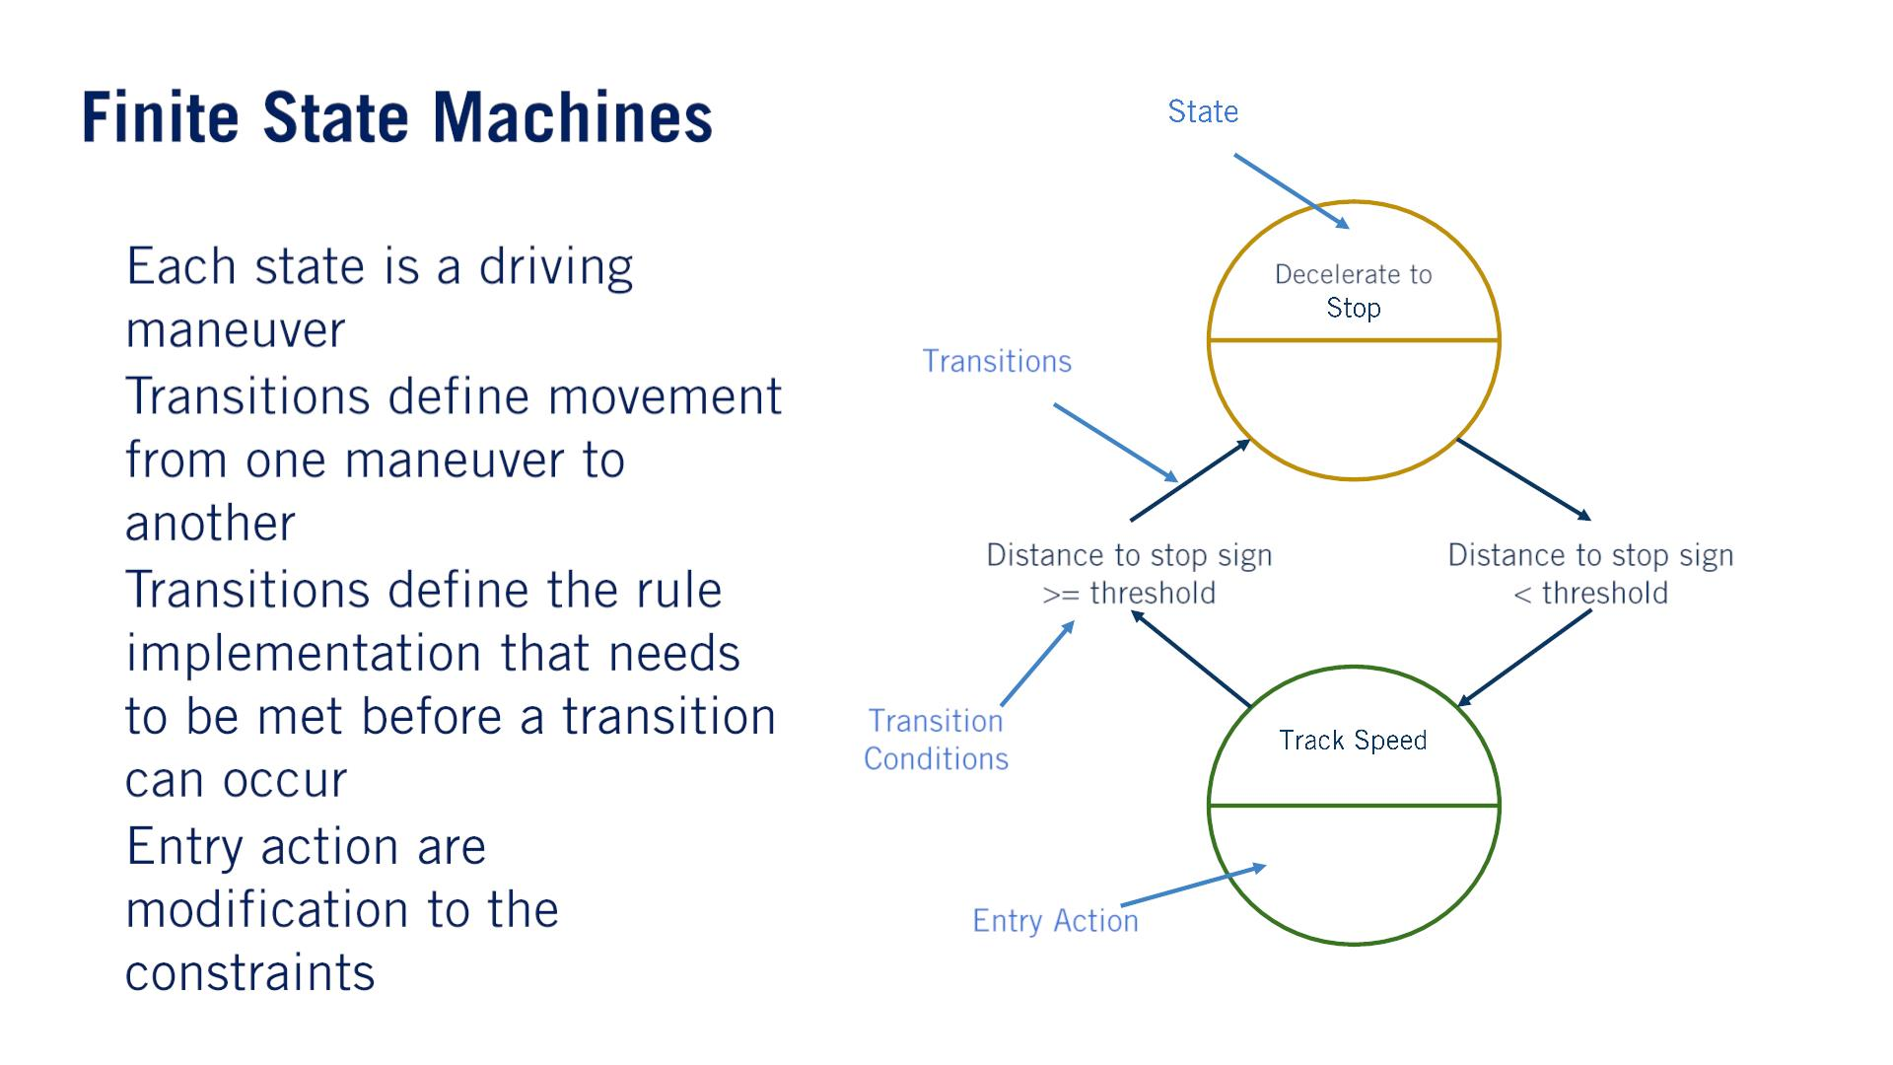
Each state has associated with it an entry action, which is the action taken when a state is first entered.
Entry actions involve setting the necessary constraint outputs to accompany the behavior decision.
•
•
푆푡표푝푃표ꢀ푛푡
= 푠푡표푝푙ꢀ푛푒
•
•
푆푝푒푒푑퐿ꢀ푚ꢀ푡
= 50 푘푚/ℎ

Slide 7
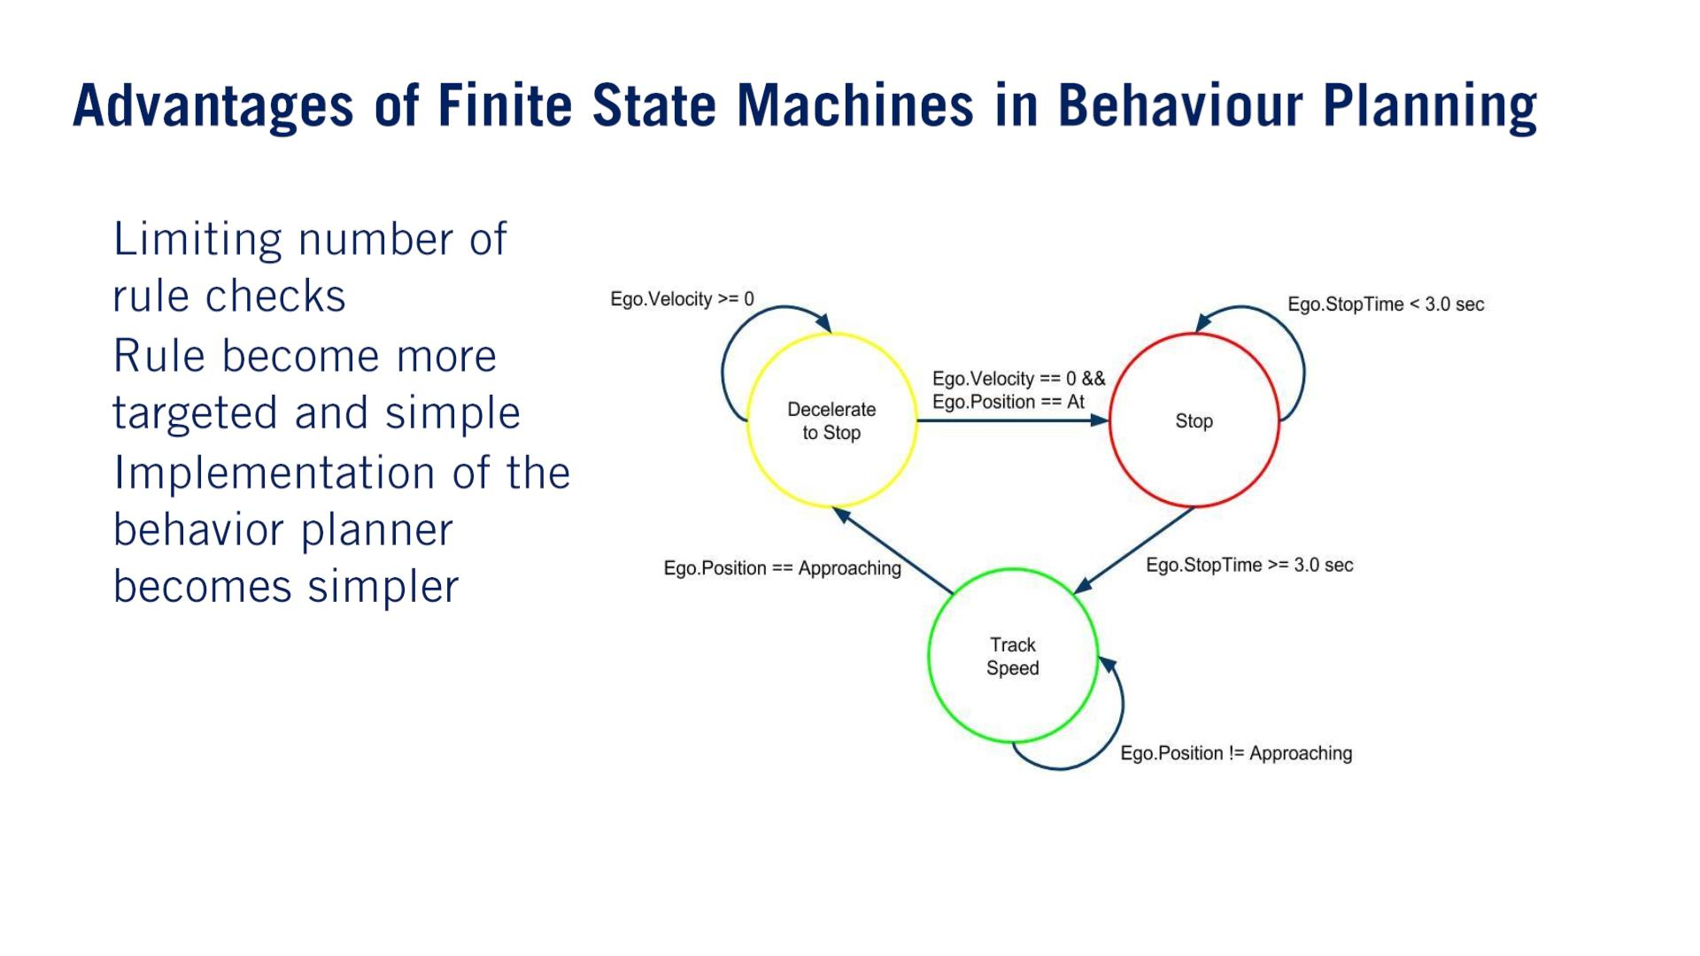
•
•
•
課題：（⼤事）
as the number of states increases, the complexity of defining all possible transitions and their conditions explodes.
There’s also no explicit way to handle uncertainty and errors in the input data.
These challenges mean that the finite-state machine approach tends to run into difficulties, as we approach full level-5 autonomy.

Slide 8
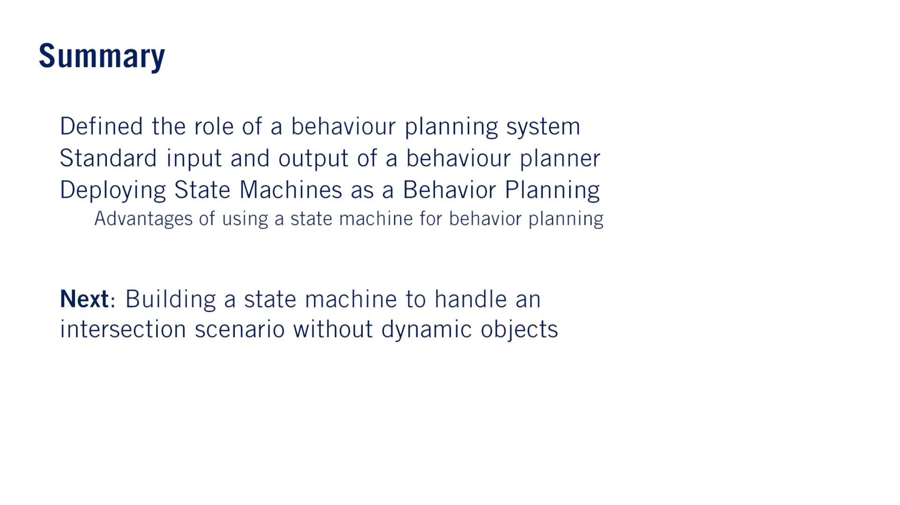
•
•
•
o
•
単語
Proximity, 近接: Proximity to a place or person is nearness to that place or person.
Cone, 円錐「えんすい」: A cone is a shape with a circular base ending in a point at the top.

Slide 9


Slide 10
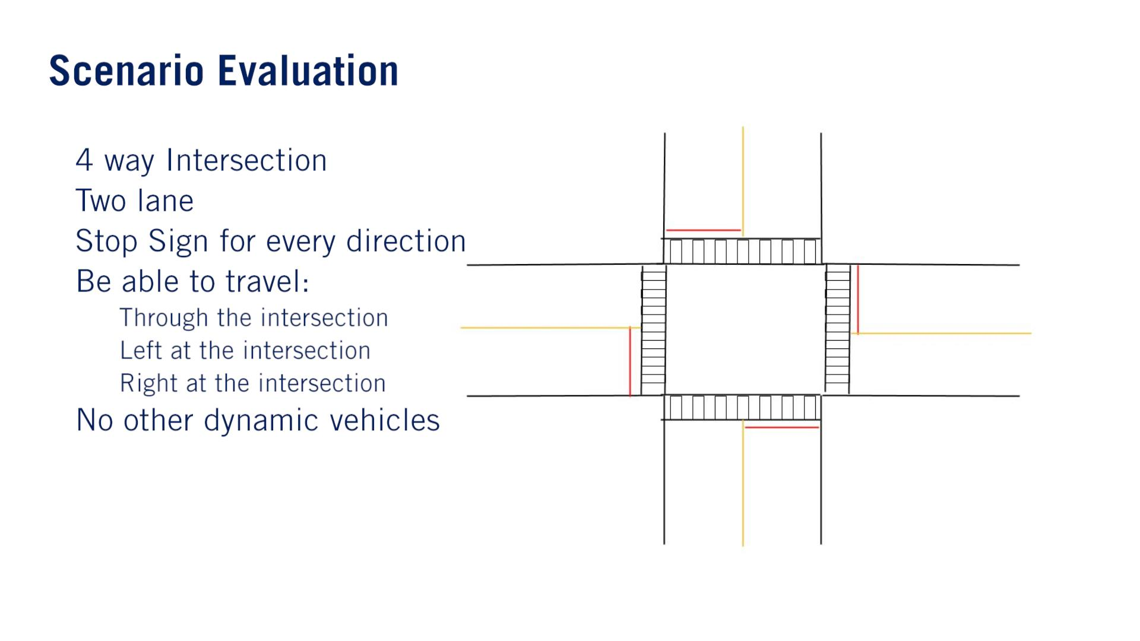
•
•
•
•
o
o
o
•

Slide 11
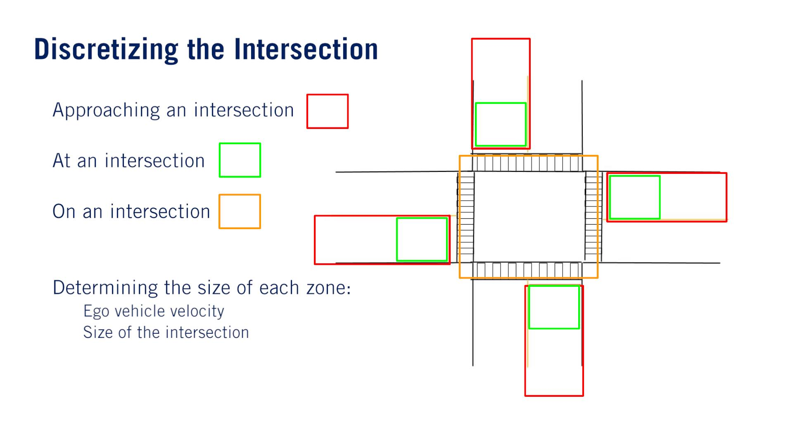
•
•
•
•
o
o

Slide 12
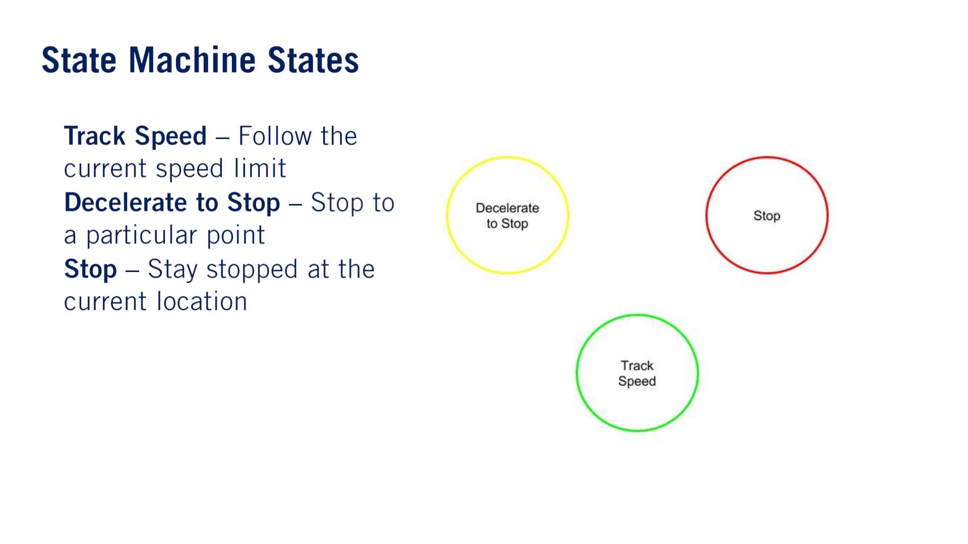
Traditionally, this is the maneuver given before entering any region of the intersection, or after entering the on the intersection zone safely.
Entry action: speed limit.
•
•
•
Entry action: stop point location.
Entry action: start a timer to wait for a fixed amount of time before proceeding through the intersection.

Slide 13
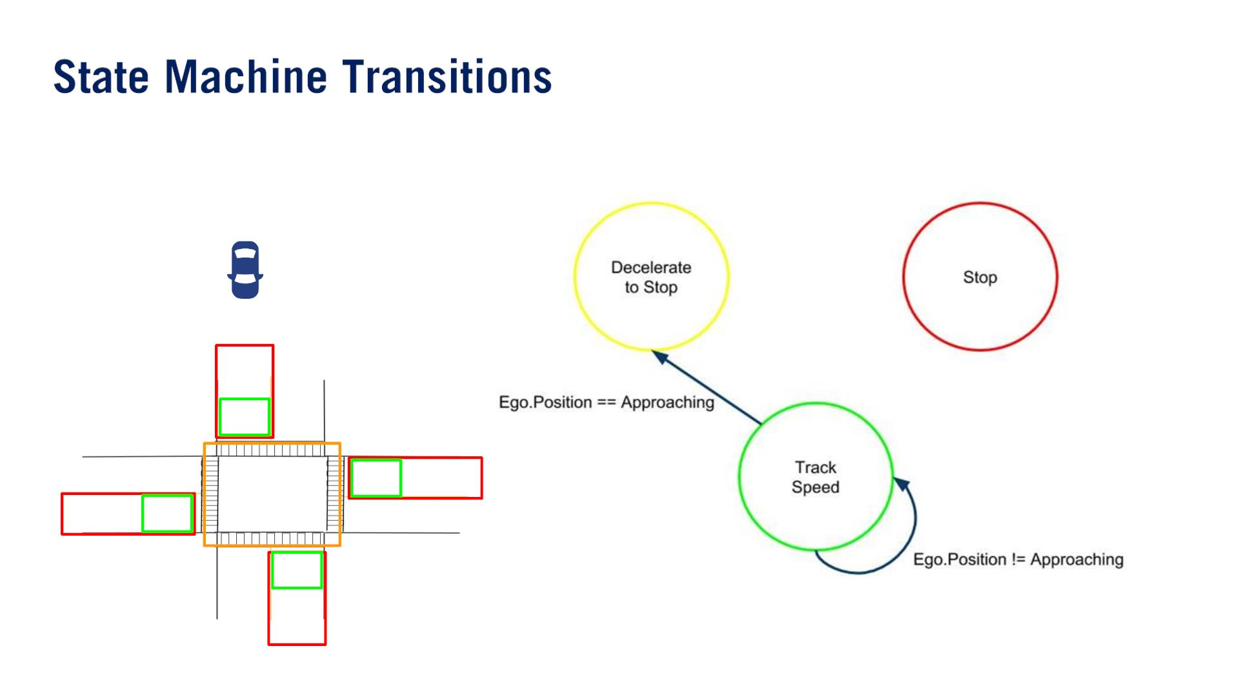
Throughout this process, it is vitally important that we understand how we, the human expert, analyze the scenario, and what the specific capabilities of the resulting behavior planner are.
These need to be captured in the operational design domain definition, and we need to ensure that we create a complete state machine able to handle every possible case that can arise for the given scenarios.
復習（C1M1L1 Taxonomy of Driving）：The ODD constitutes the operating conditions under which a given system is designed to function. Clearly defining the operating conditions for which a self-driving car is designed, is crucial to ensuring the safety of the system.

Slide 14
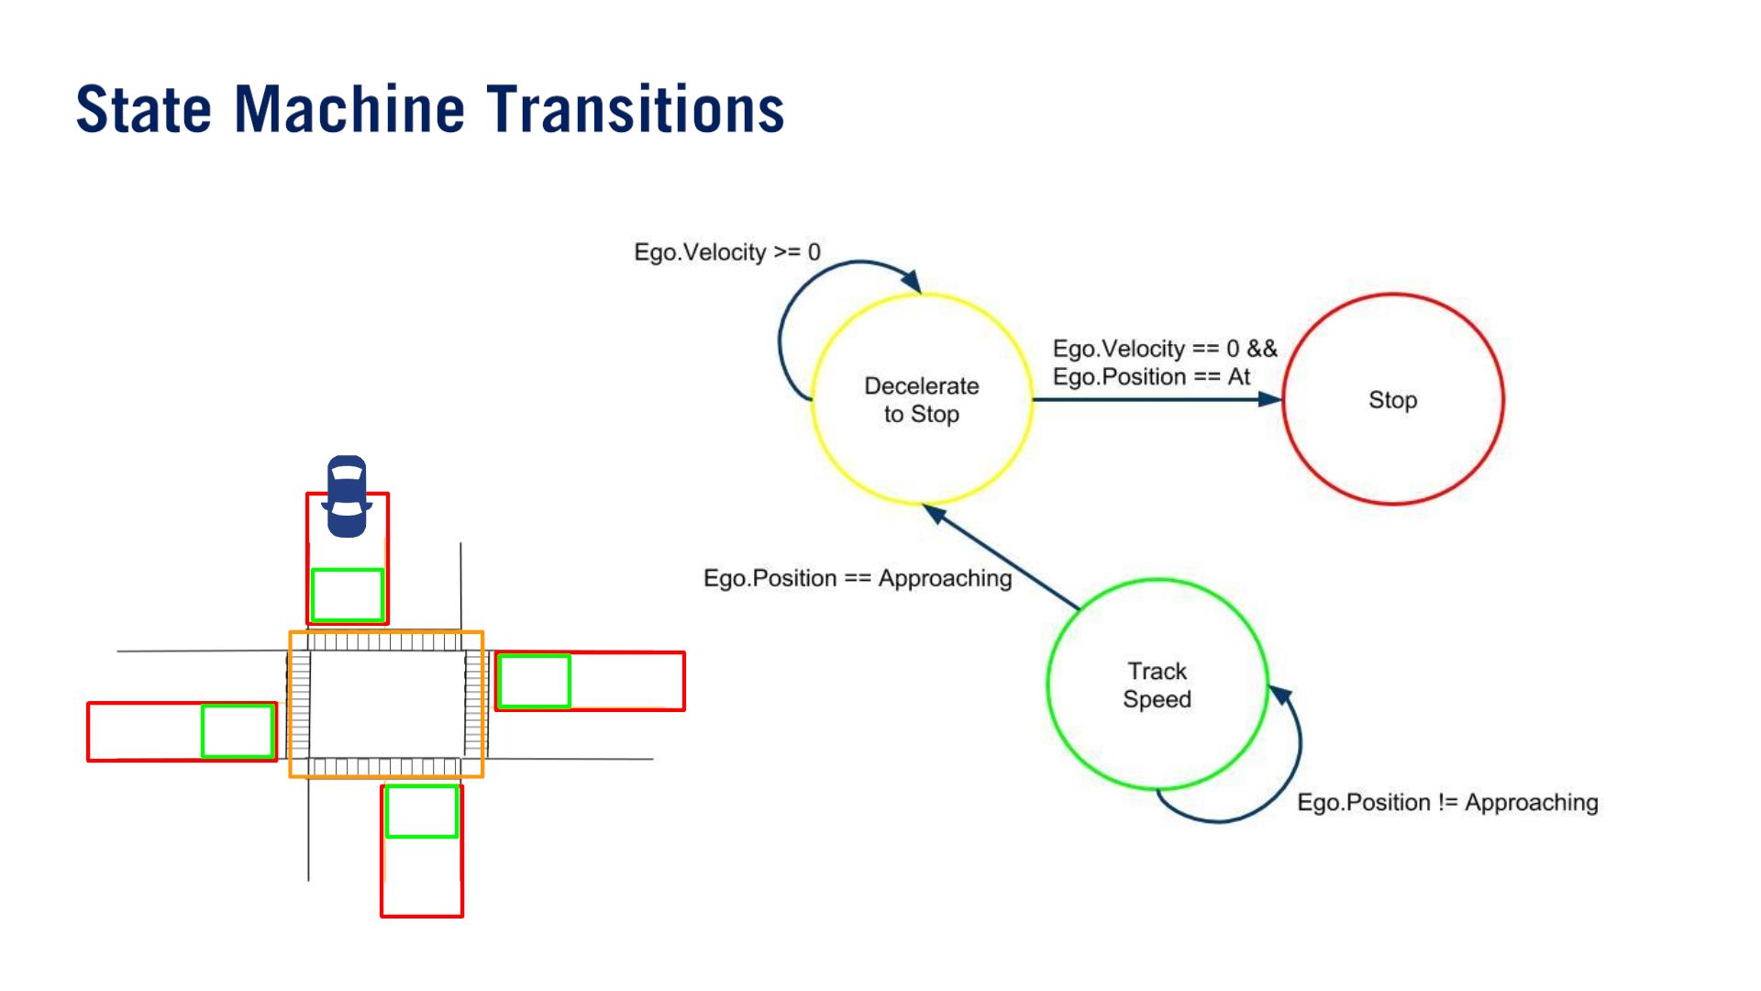

Slide 15
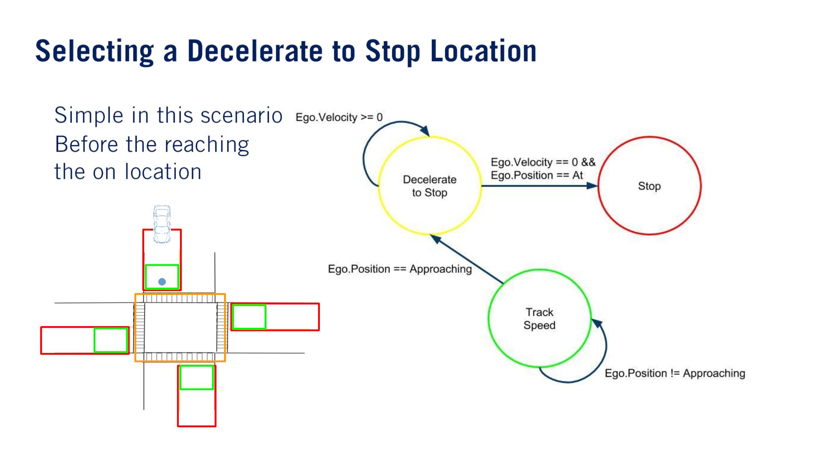
•
•

Slide 16
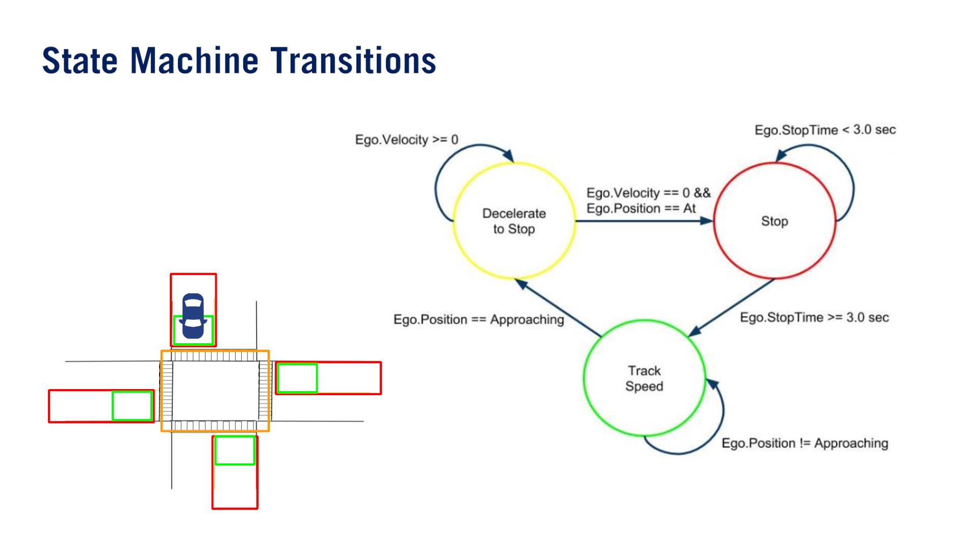

Slide 17
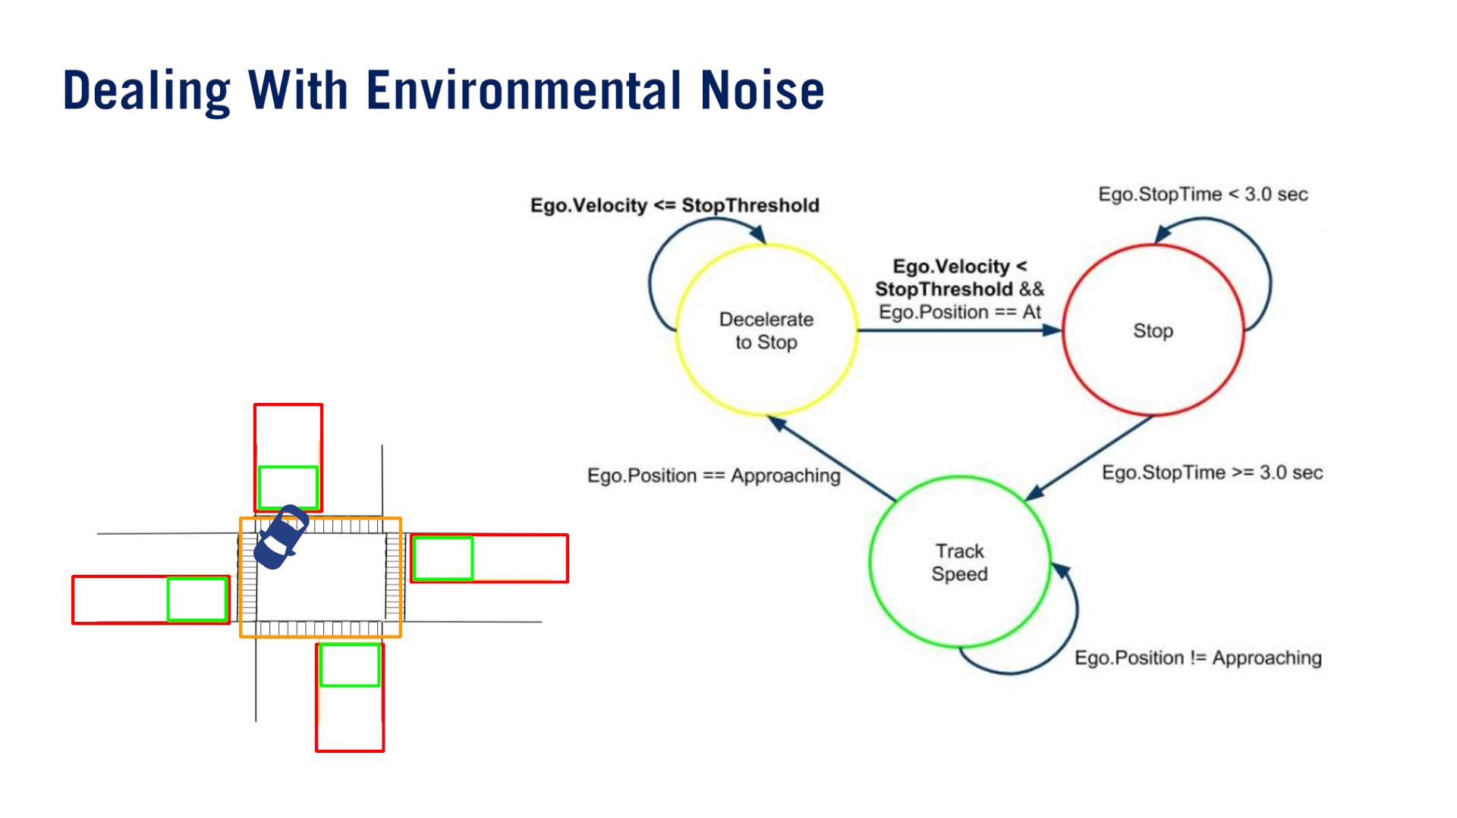
One particular issue that has a big impact on the performance of our state machine is the issue of noise in the inputs.
The state transition conditions defined above are exact, and rely on the vehicle reaching the stop point and achieving a zero velocity exactly.
Even with no other dynamic objects to detect, the localization estimates of the vehicle state may contain noise and not satisfy these conditions exactly.
対策：noise threshold hyperparameters.
Small threshold value allowing speeds close to zero to be accepted as stopped.

Slide 18
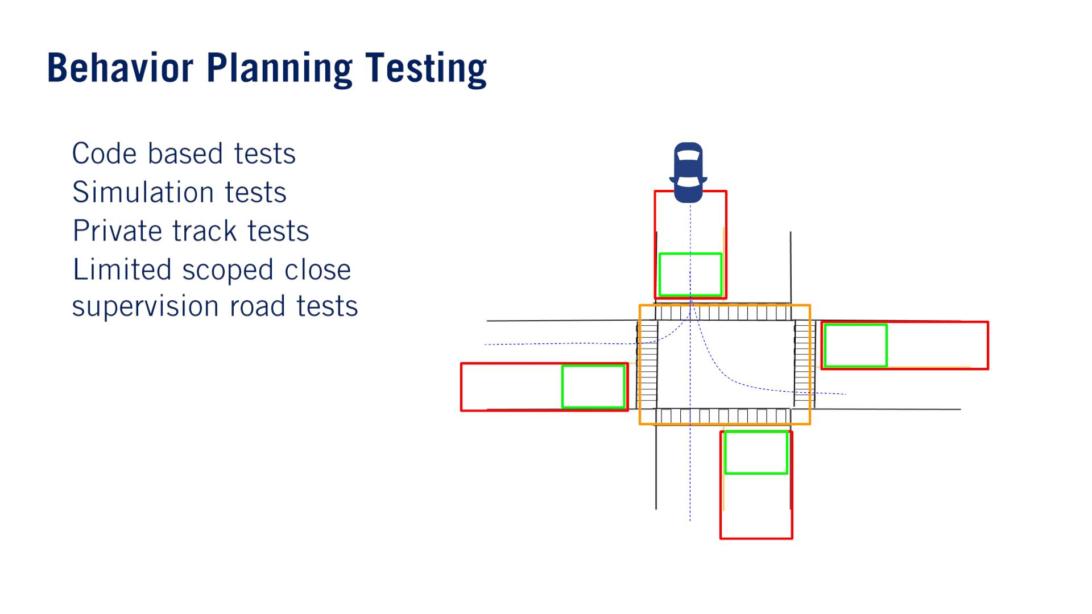
once confident that the state machine performs as intended in simulation.
This type of testing tests specific scenarios which are hard to confirm exactly in simulation, such as parameter tuning and noise, and errors in the perception output in a real environment.
（⼤事）
Incapable of confirming if the state transitions are correct, or if the states are capable of handling all of the situations in a given scenario.
•
•
•
•
Performed in a simulated environment like Carla.
Able to confirm if the state machine transitions and state coverage are correct.
The number of tests performed in the simulation should be representative of all possible situations which can be seen when driving the scenario to catch any edge cases which programmers might have missed.
Many times selecting a representative set of tests is not trivial, especially as the complexity of the scenarios increases.

Slide 19
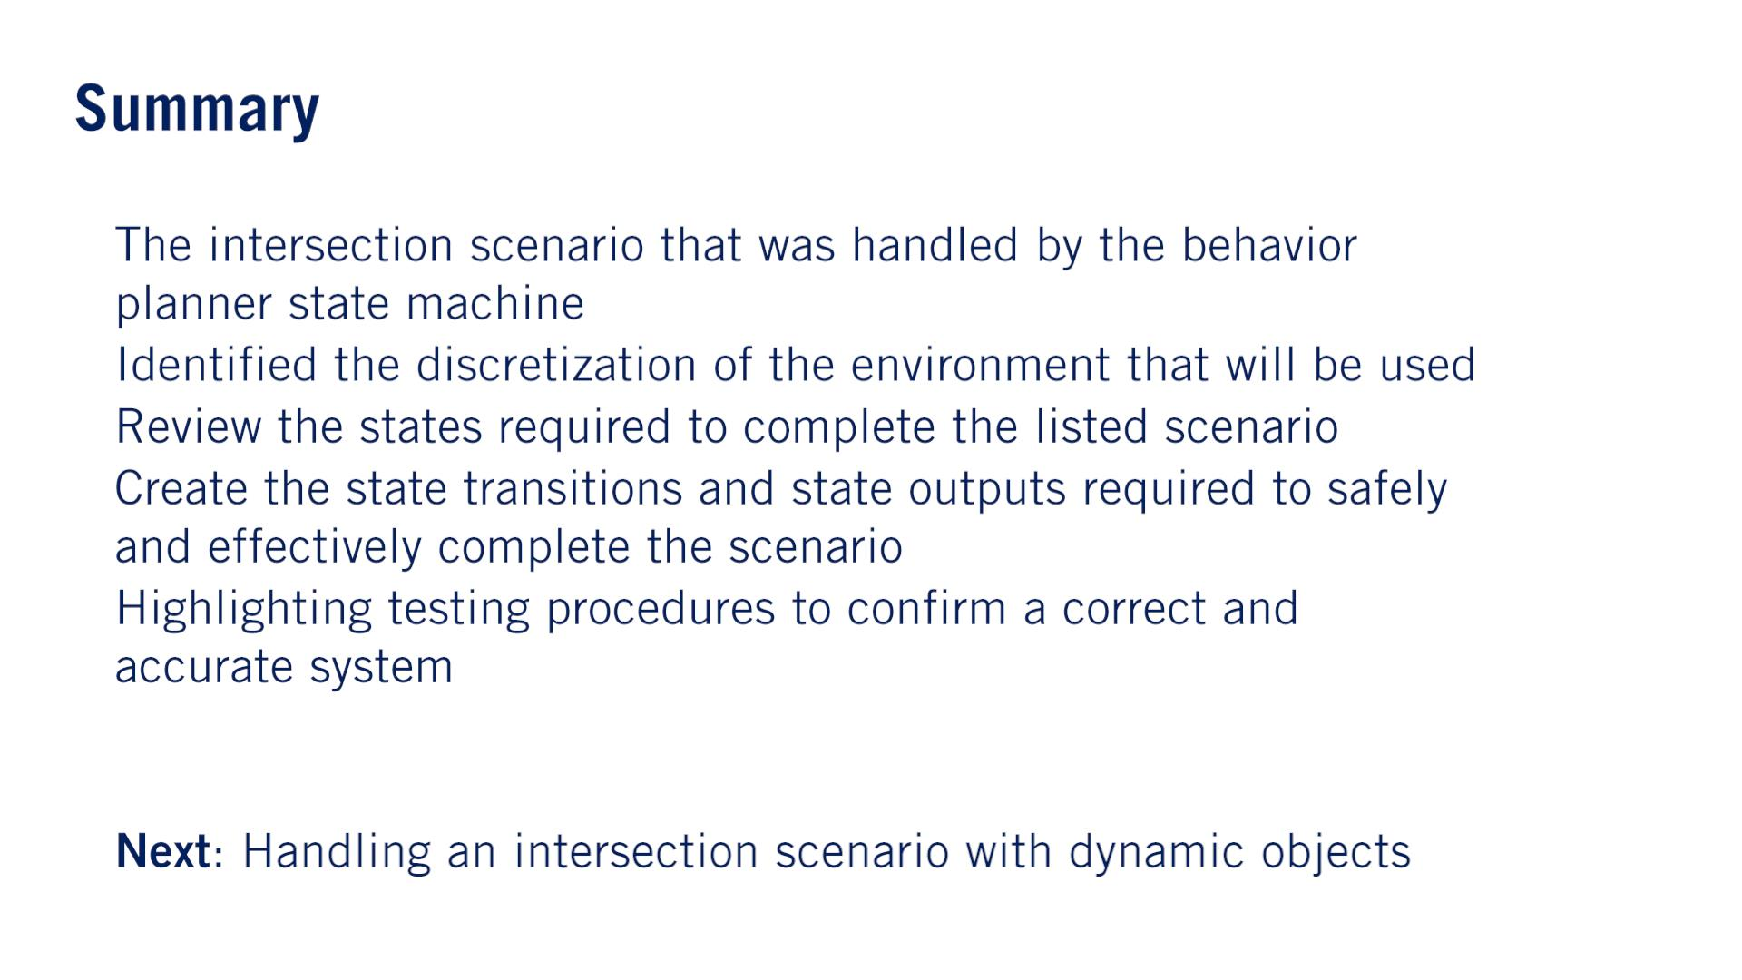
•
•
•
•
•
•

Slide 20

Handling An Intersection Scenario With Dynamic
Objects

Slide 21
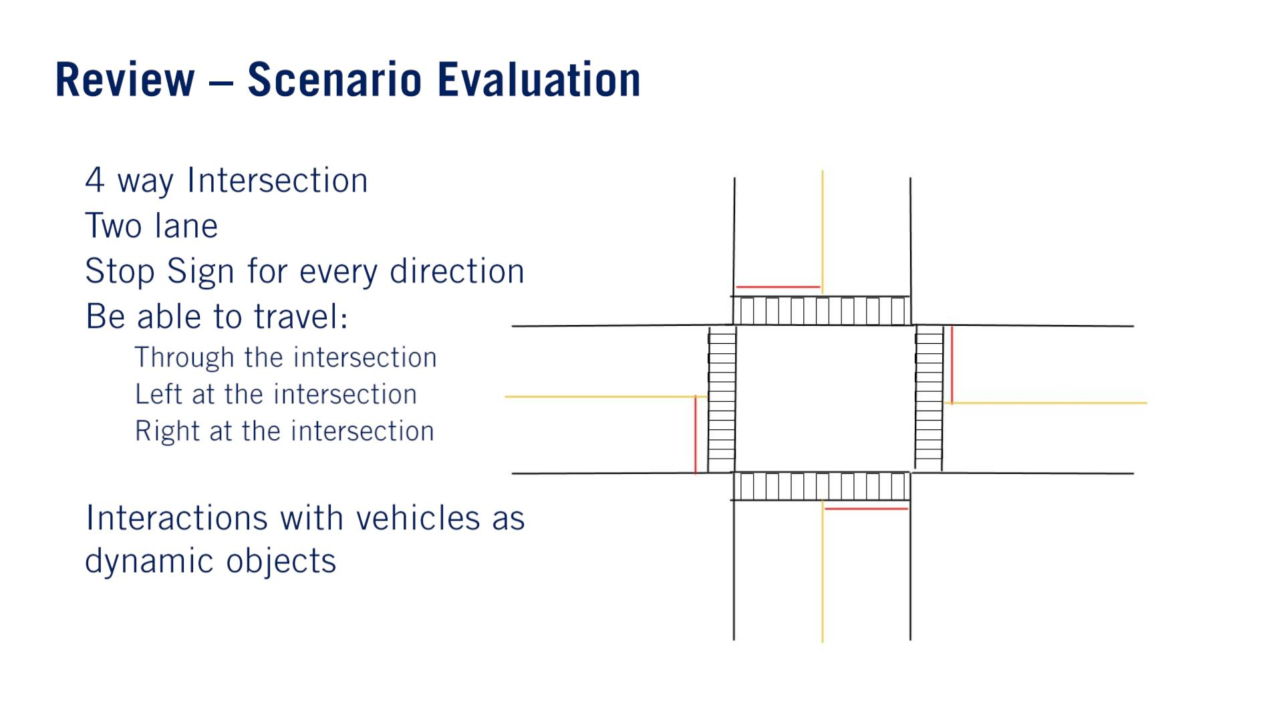
•
•
•
•
o
o
o
•

Slide 22
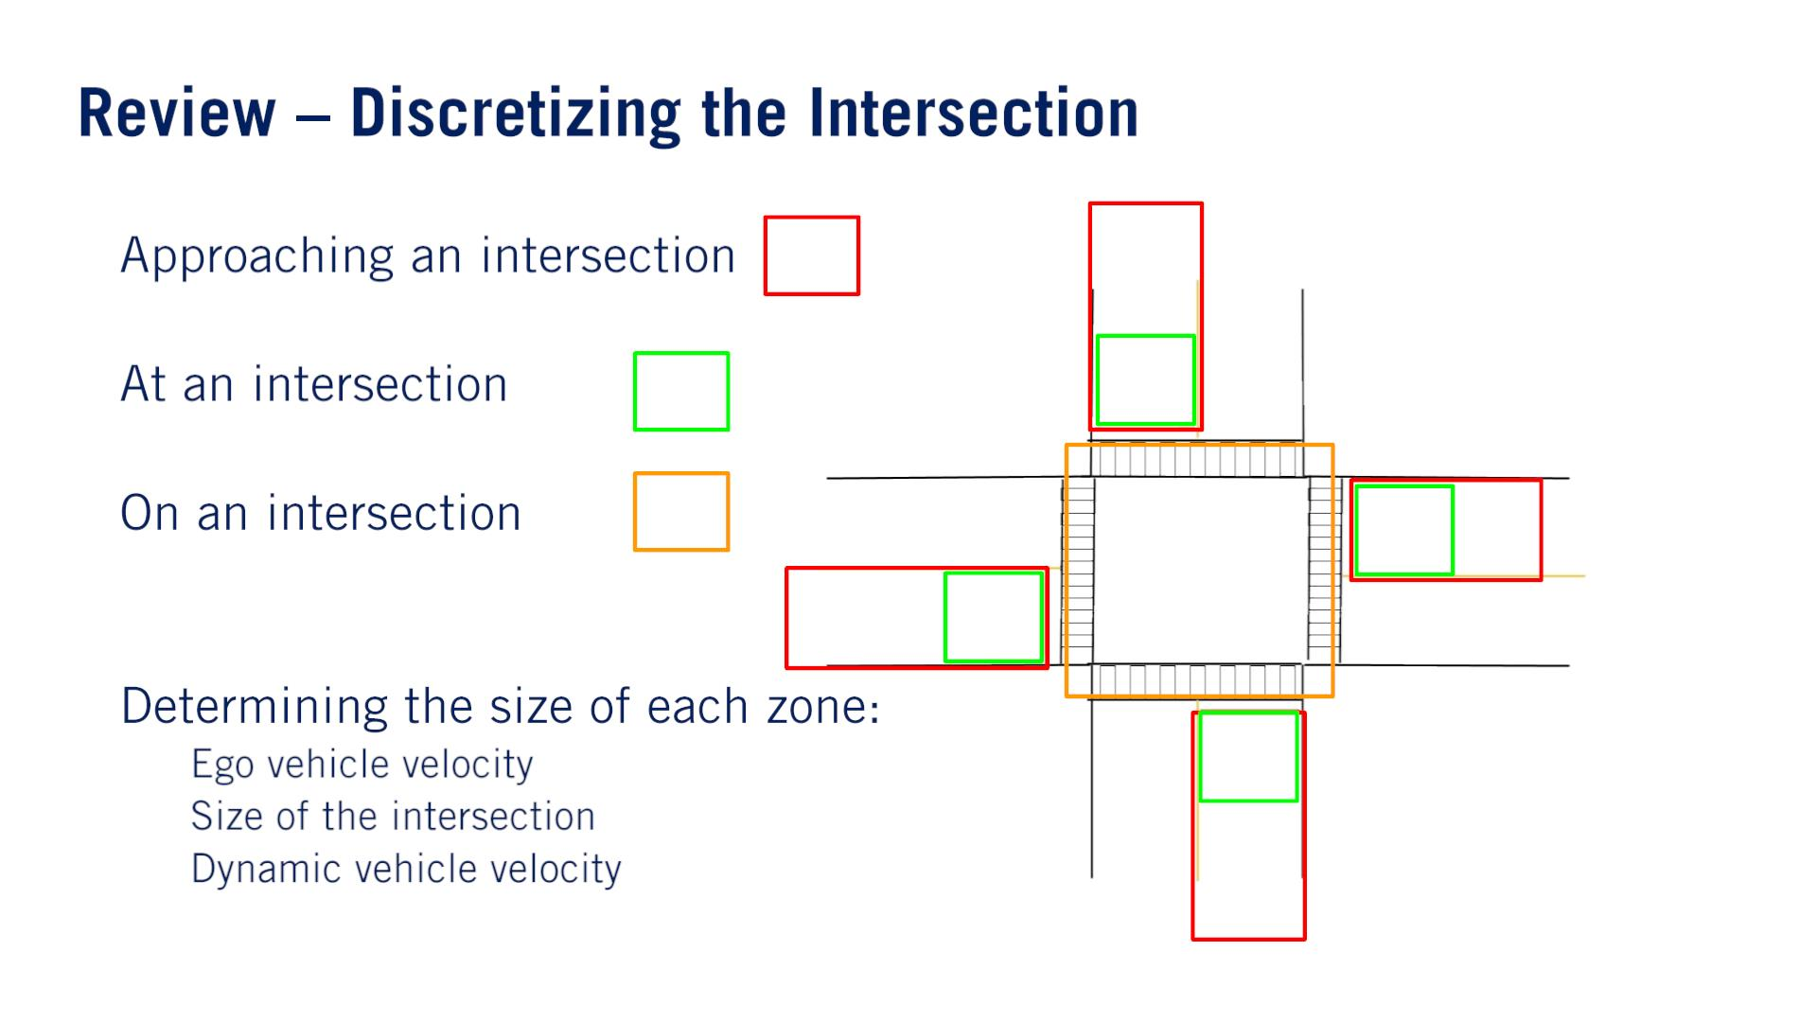
•
•
•
•
o
o
o

Slide 23
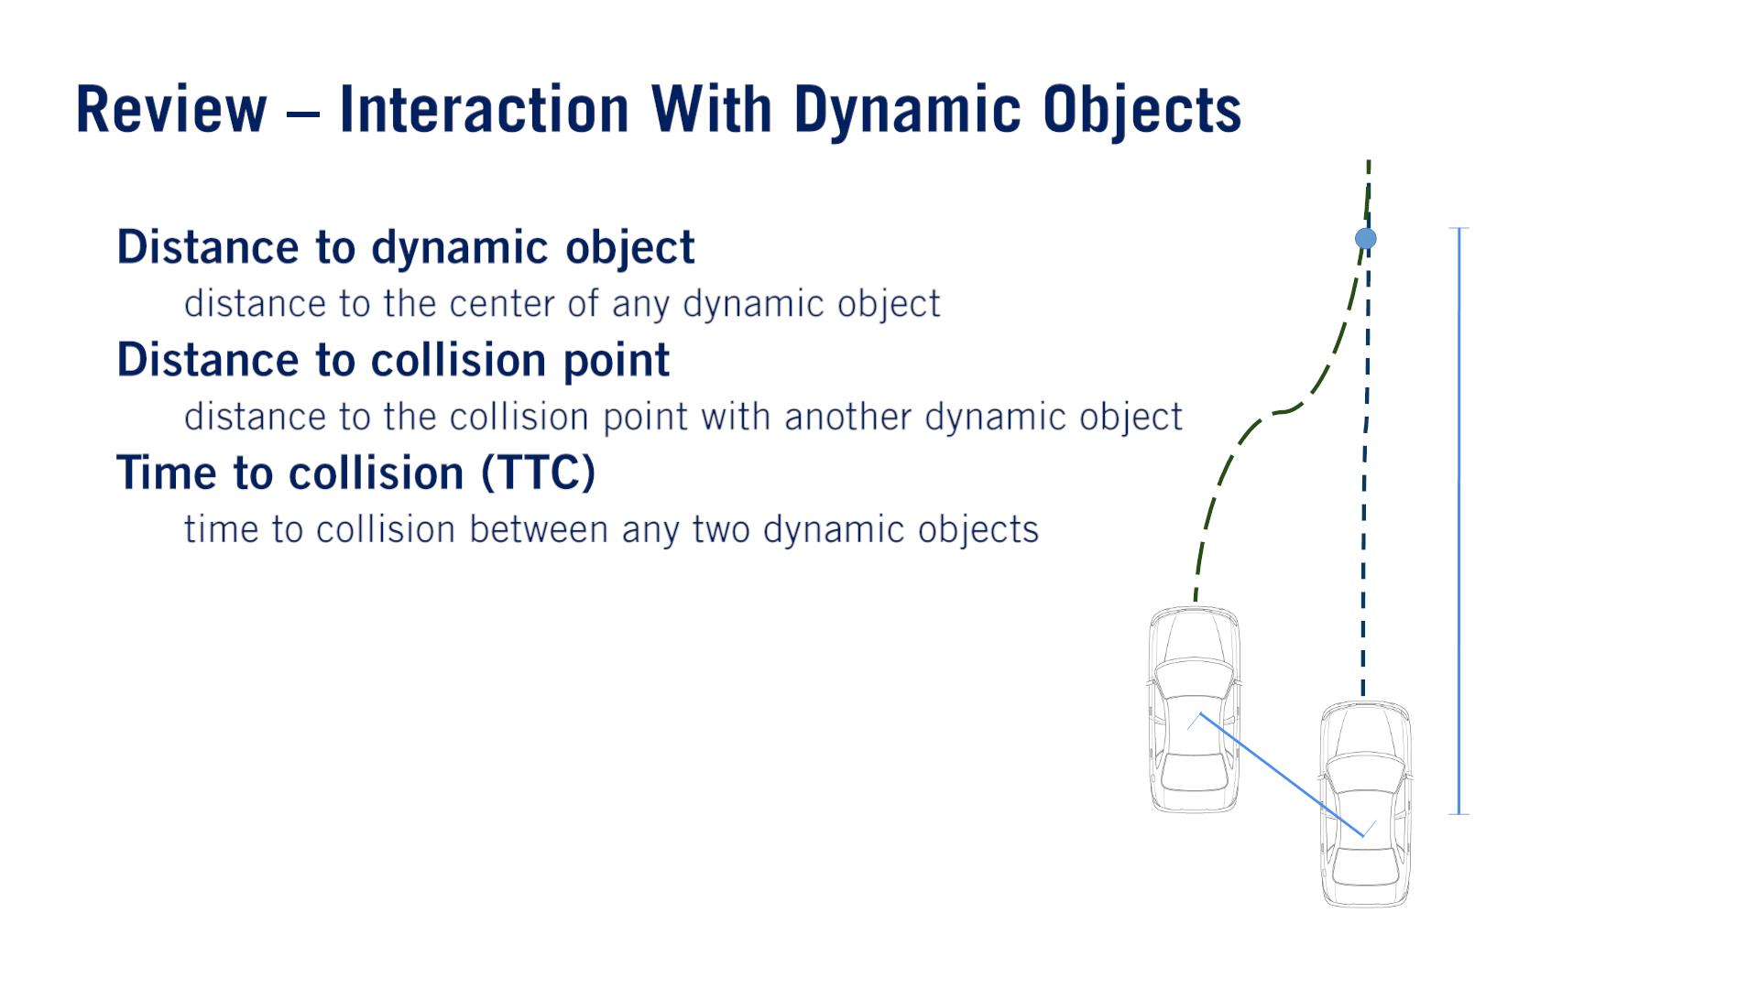
3.24 Sec
•
•
•
o
o
o
5.72 m
1.52 m

Slide 24
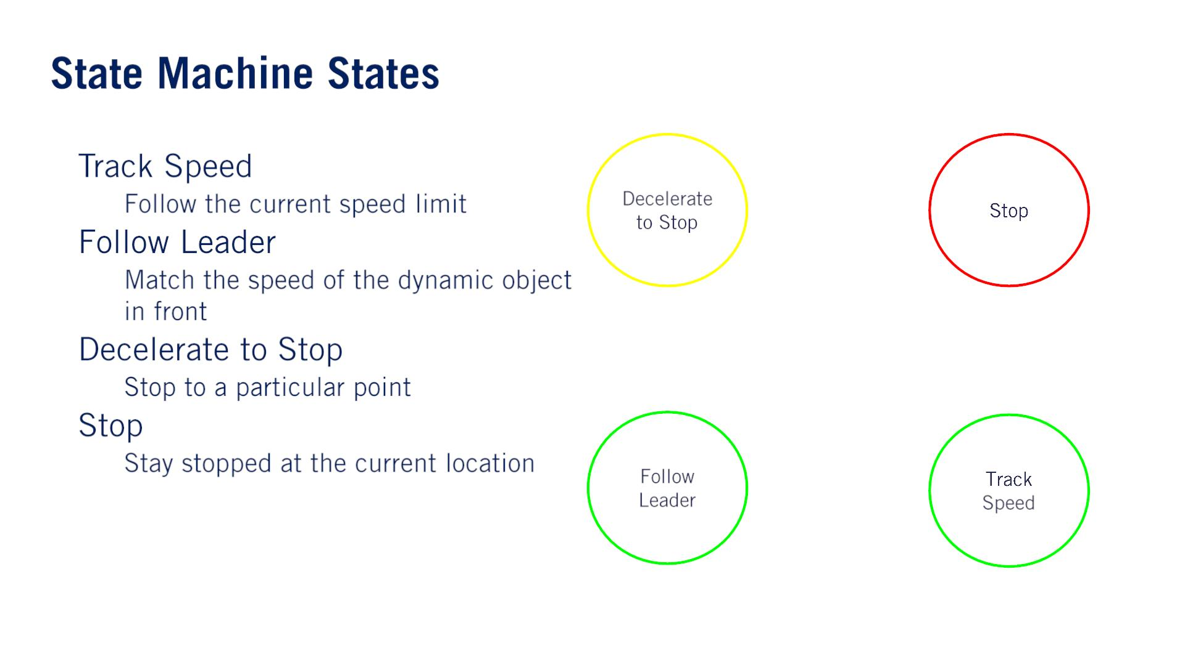
•
•
o
o
The safe distance is speed dependent and both safe speed and safe distance are updated as entry actions on every iteration of the behavior planner.
•
•
o
o

Slide 25
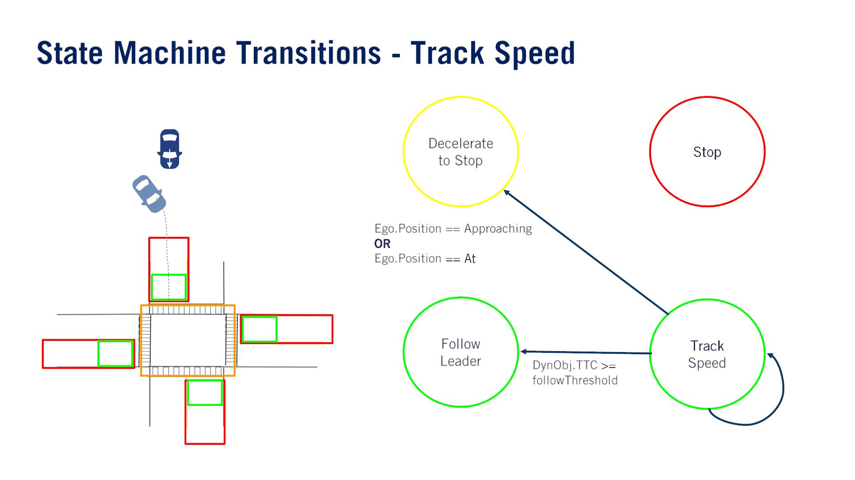
Another vehicle appears or enters the lane in front of the ego vehicle.前⾞が入り込んだ。
Follow check: A distance check; A same lane check.
For simplicity, check if the lead vehicle is within the lane limits and if the heading of the dynamic object is within a given threshold to that of the ego vehicle.
<=だと思う

Slide 26
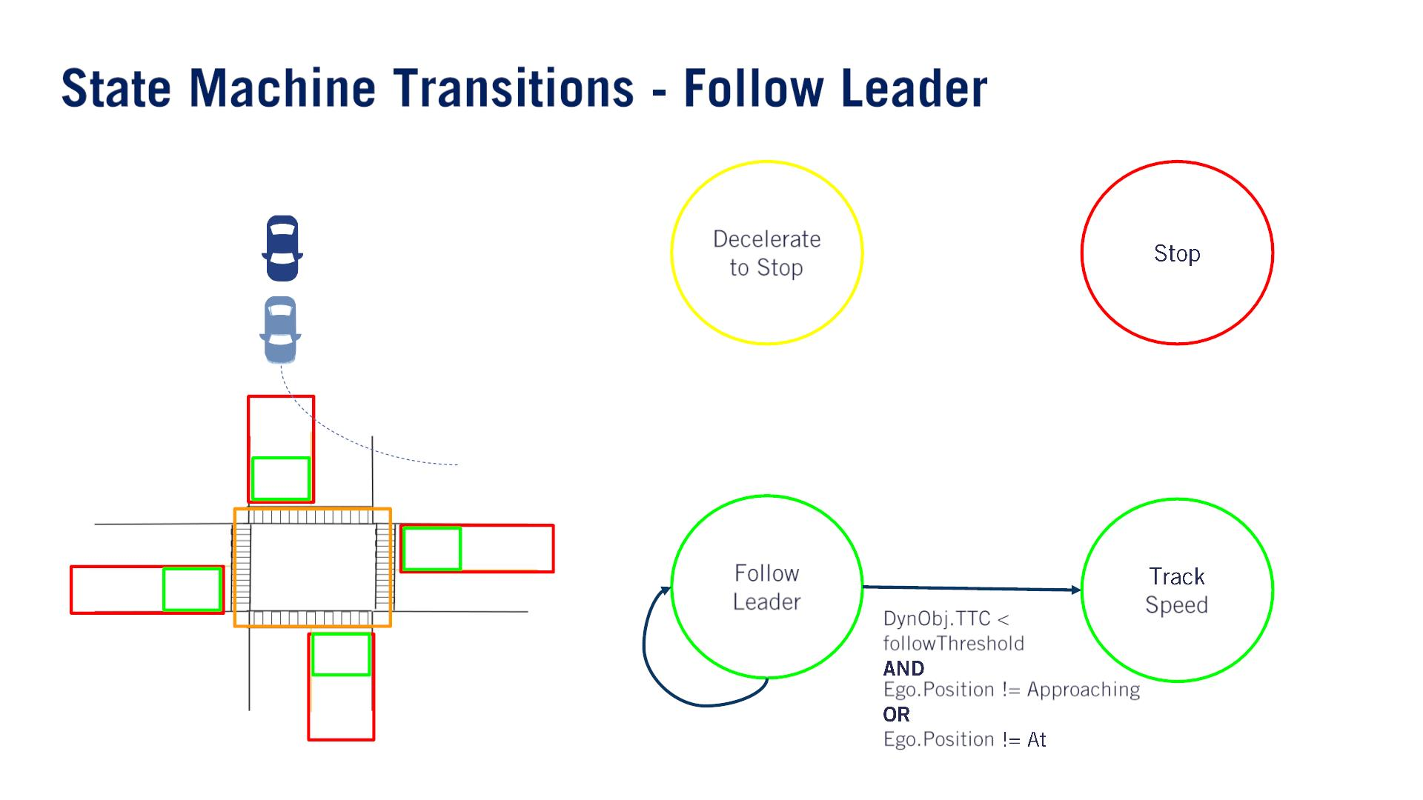
The lead vehicle might exit the lane before the ego vehicle is approaching or at the intersection. 前⾞が⾞線変更しちゃった。

Slide 27
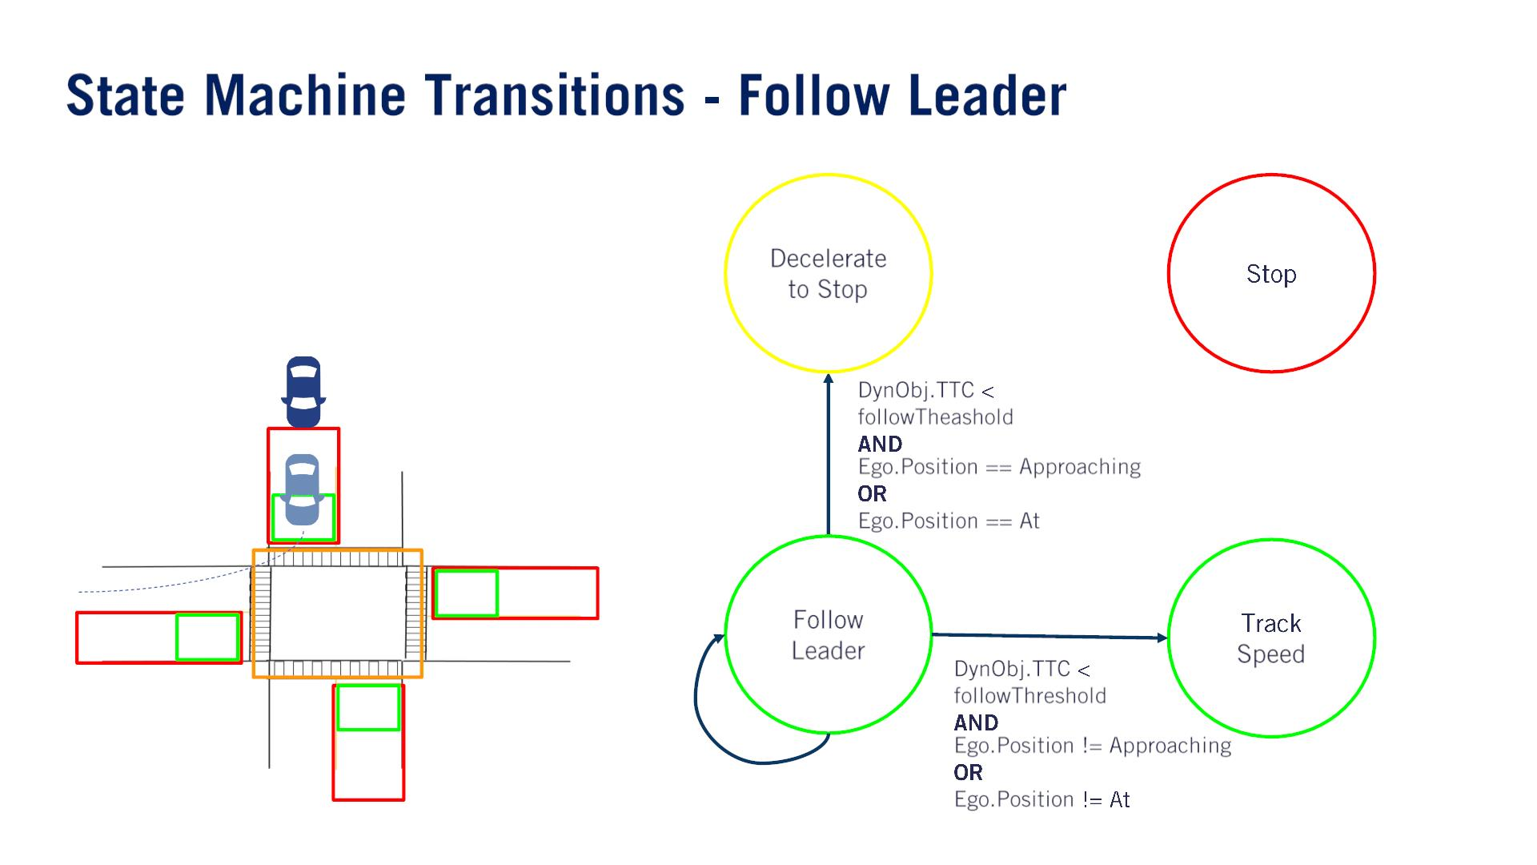
The lead vehicle drives out of the current lane onto the intersection. 前⾞が交差点に入った。
両方ともDynObj.TTC > followThresholdだと思う

Slide 28
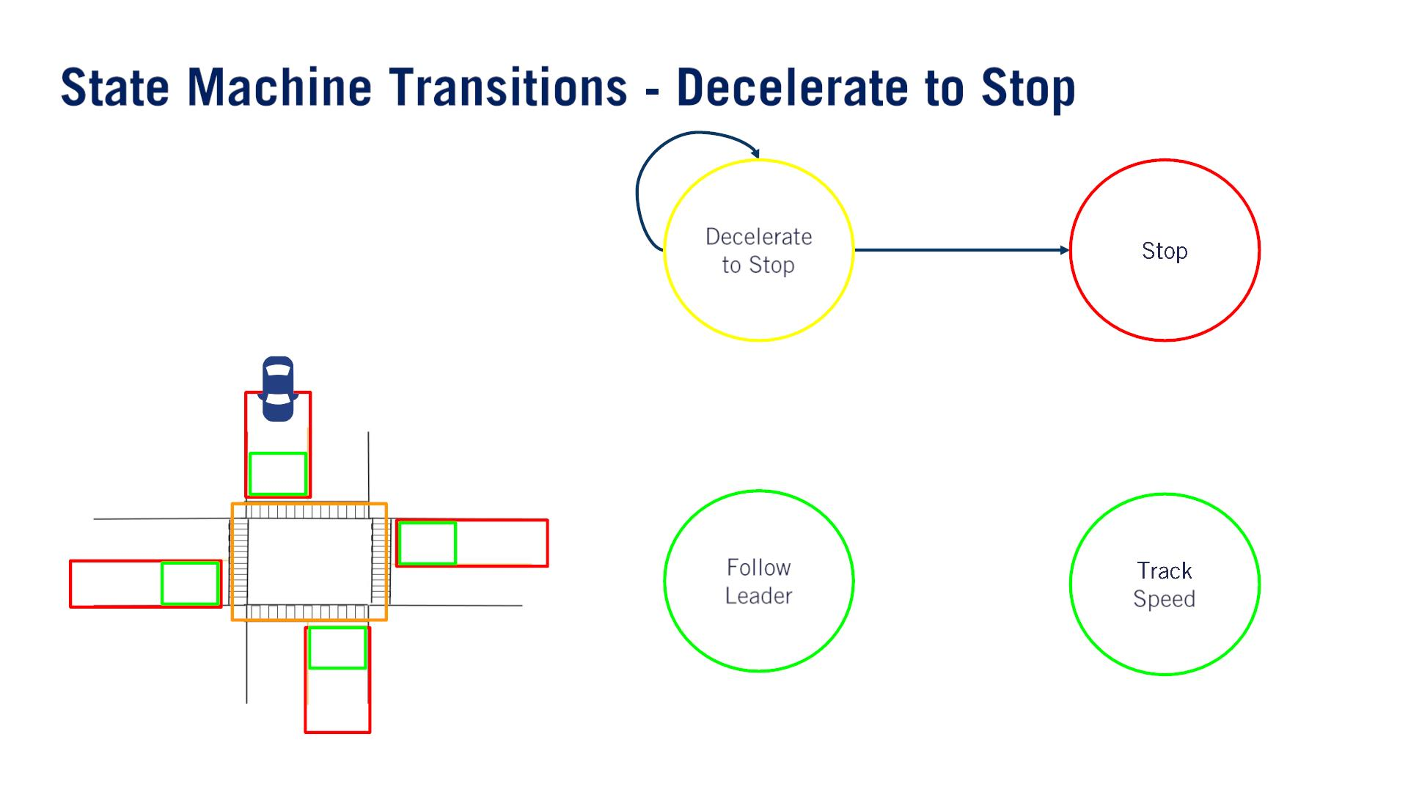

Slide 29
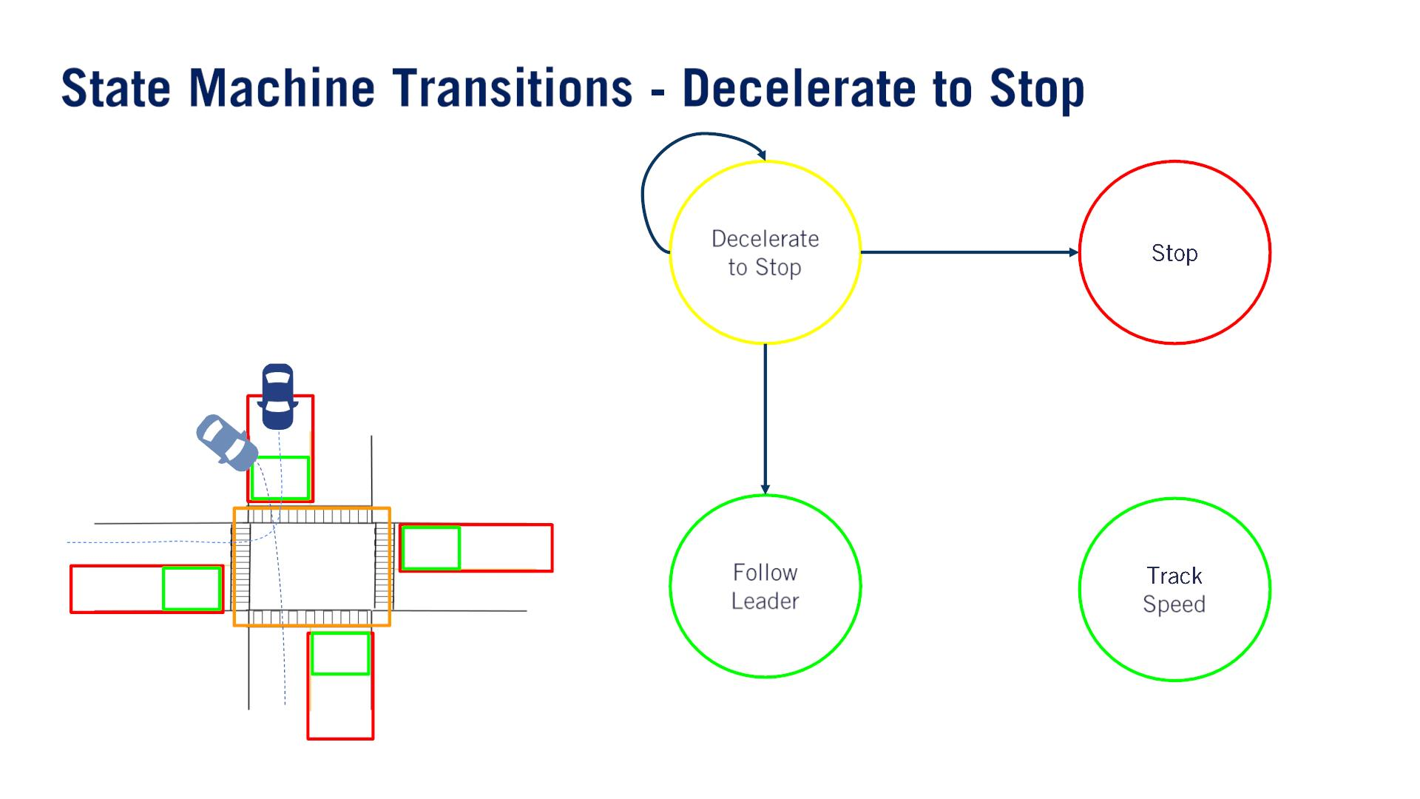
A vehicle is able to pull in front of the ego vehicle at an intersection, either from a driveway（私道） or an overtaking maneuver.⾃⾞が減速中、前⽅⾞が入り込んだ。
follow check, throughout Decelerate to Stop.
the distance check considers whether the lead vehicle distance to collision is less than the stop point distance.

Slide 30
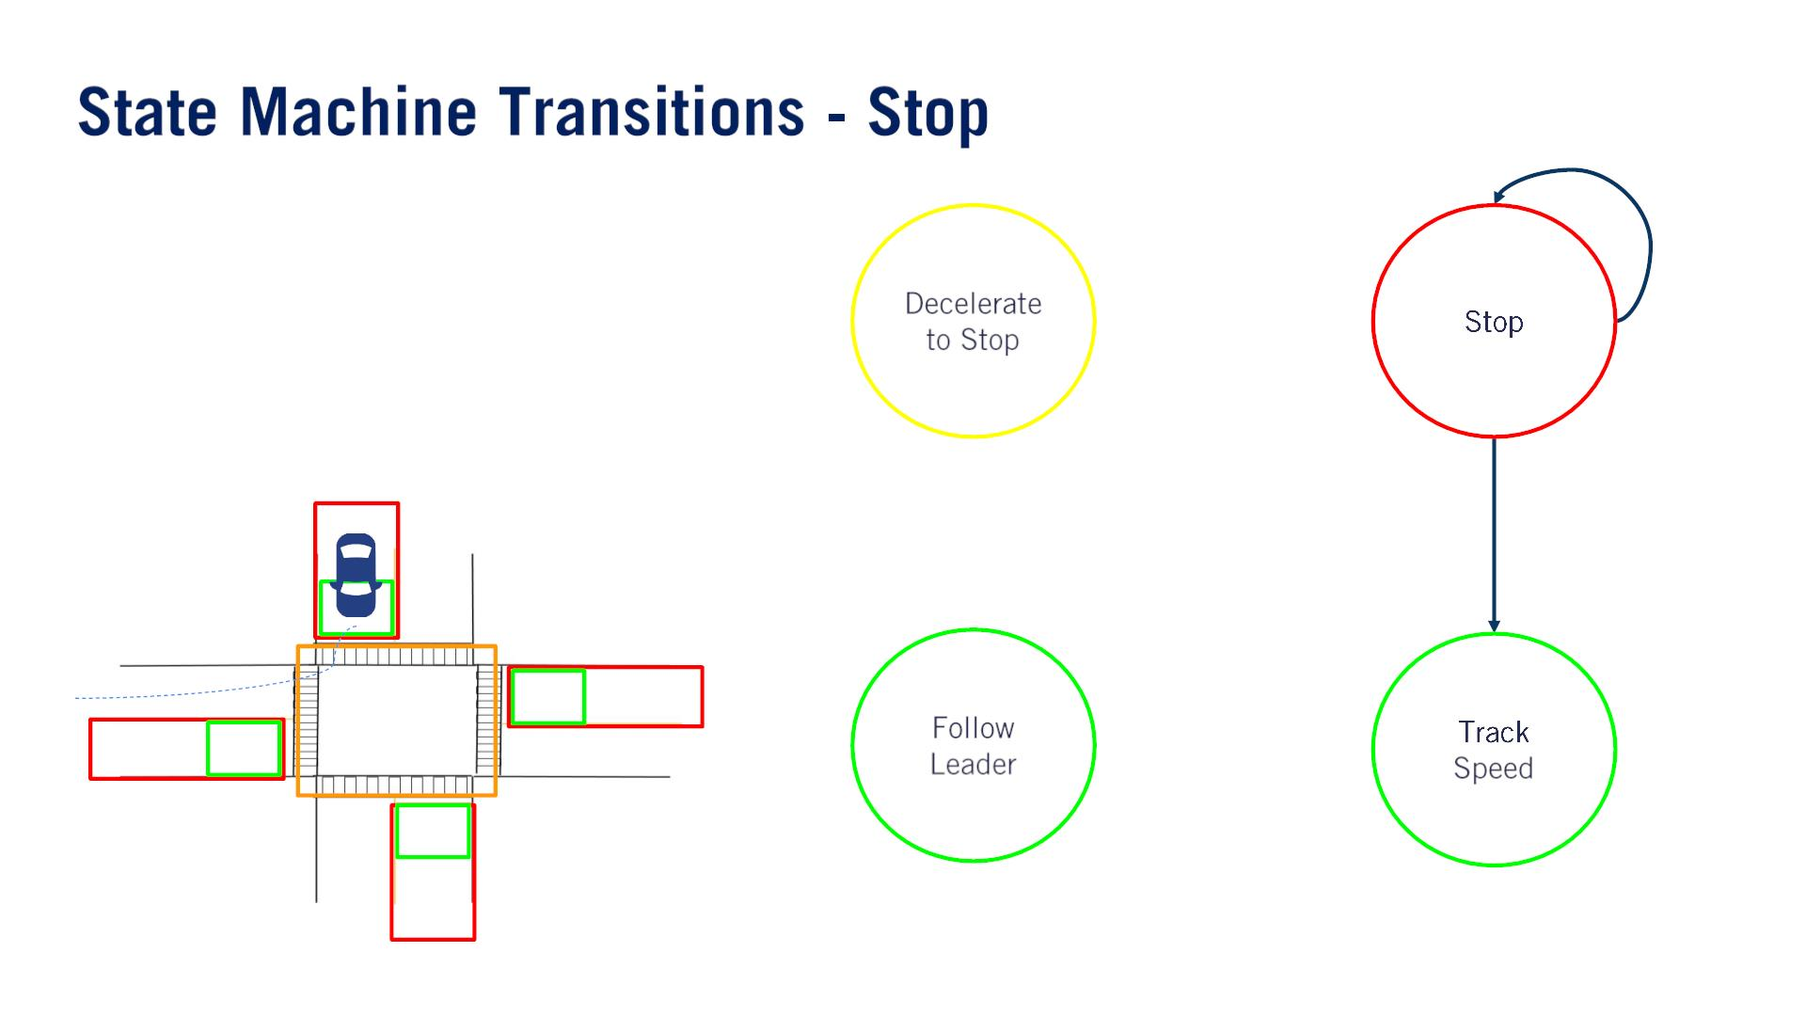
Turn left, any vehicle approaching from the left, right, or any oncoming vehicle, must clear the on intersection zone, before the ego vehicle can proceed.
Go straight, only vehicles approaching from the left or right need to clear the intersection.
Turn right, only vehicles approaching from the left（このleftは自車から見たでしょう） need to clear the intersection.

Slide 31
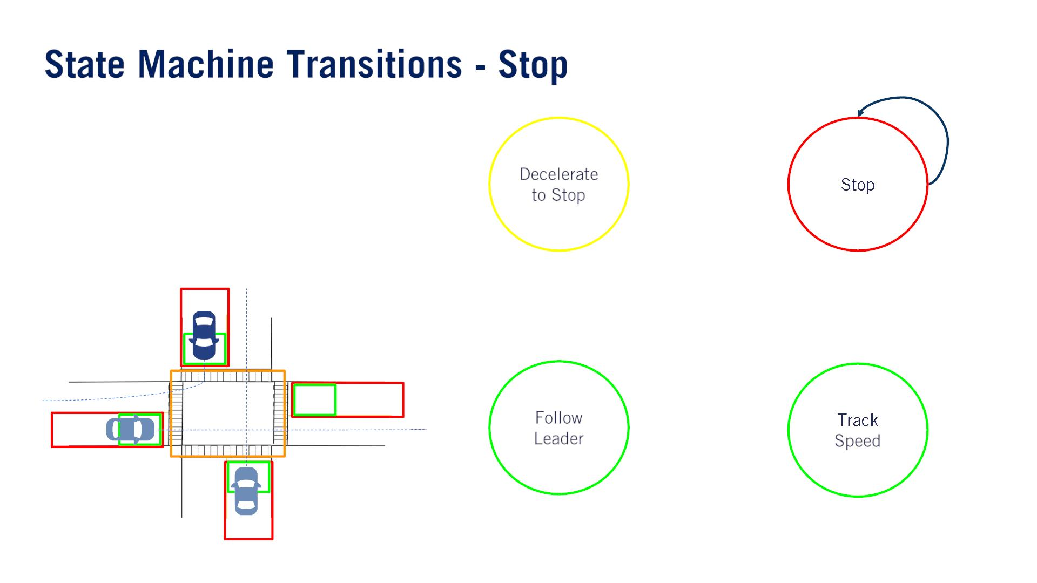

Slide 32
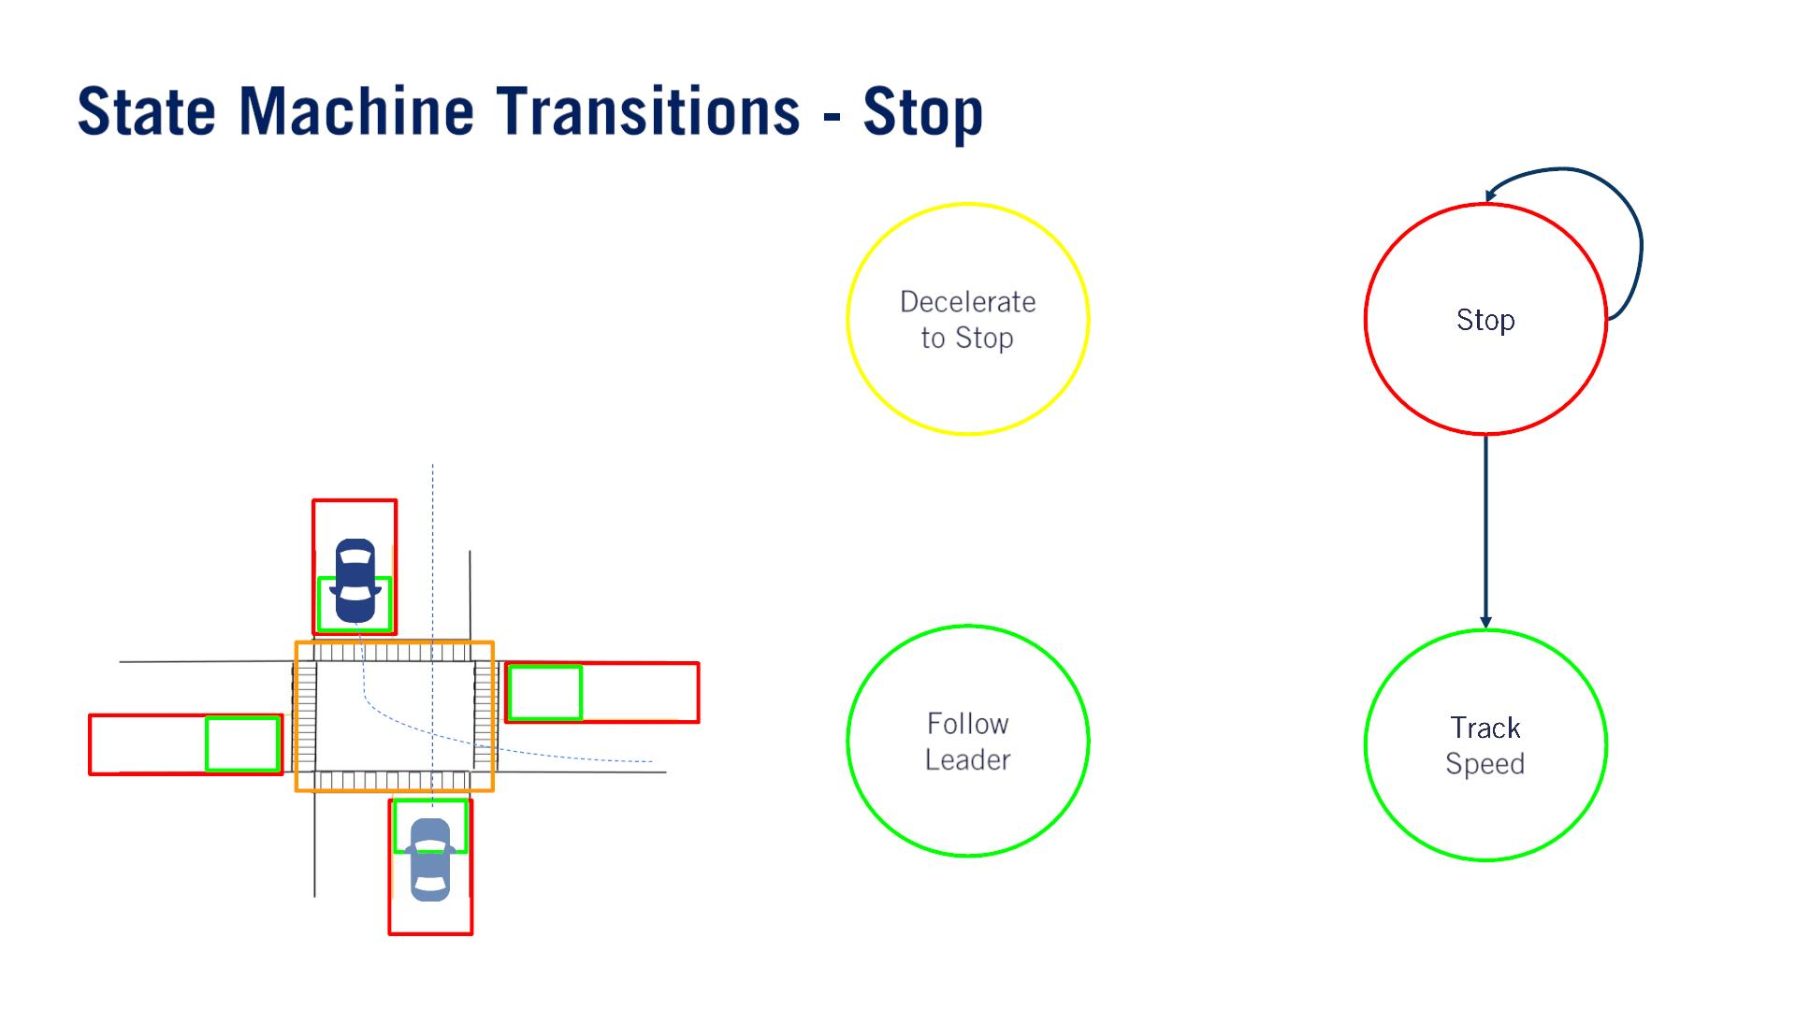

Slide 33
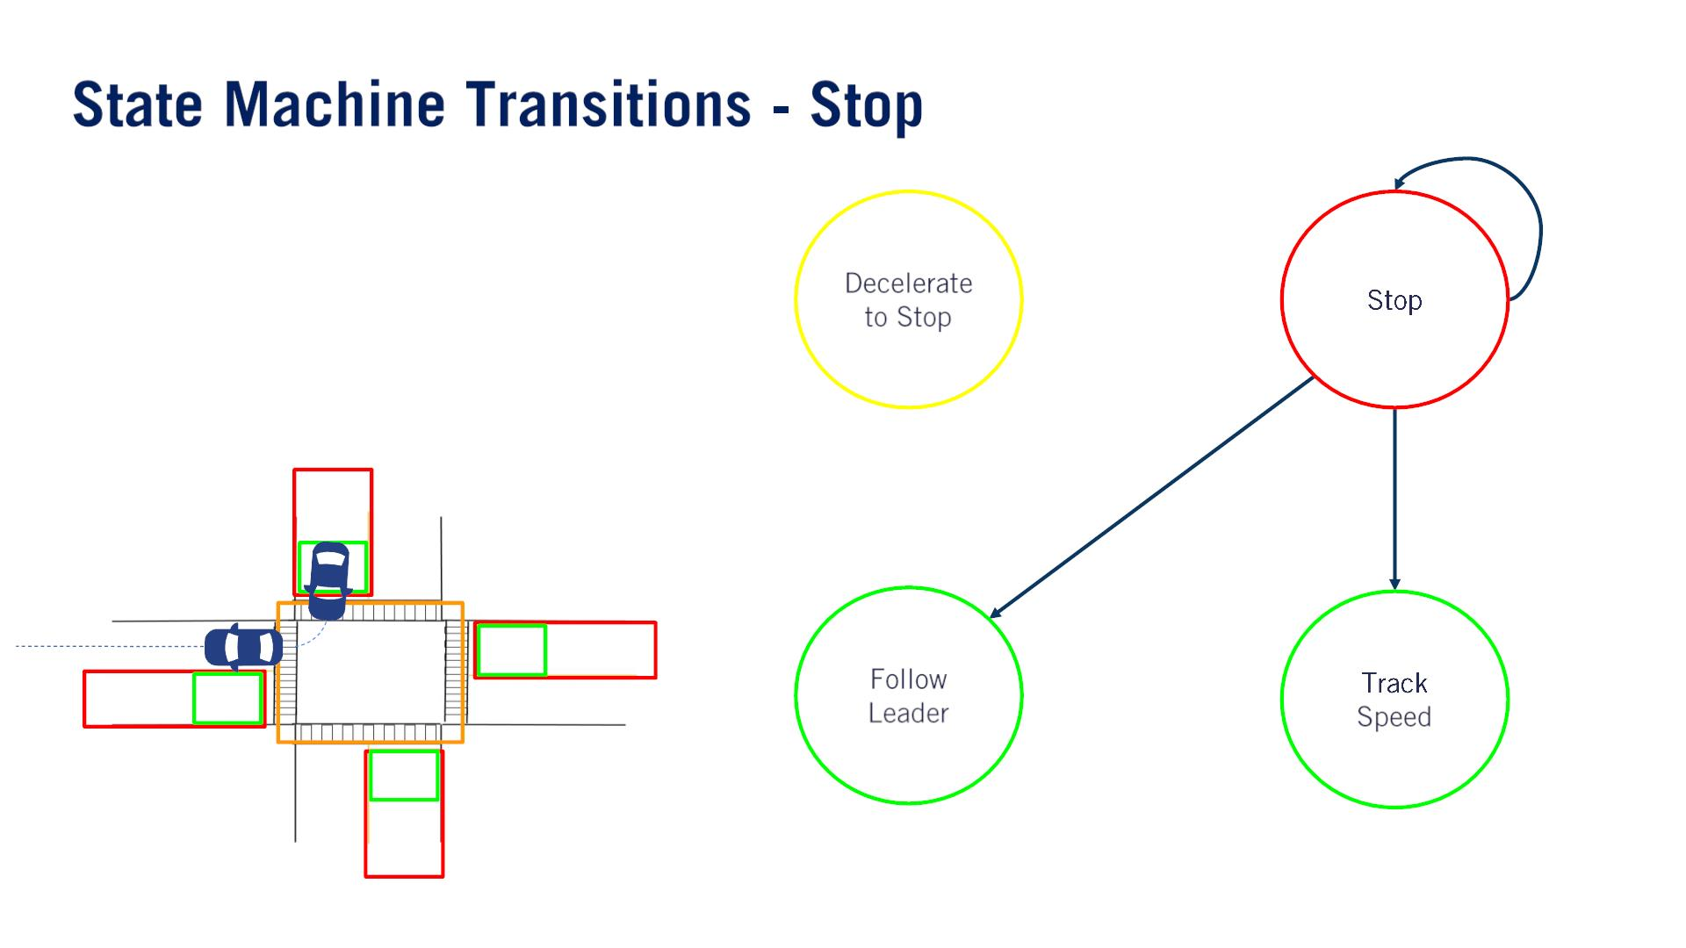

Slide 34
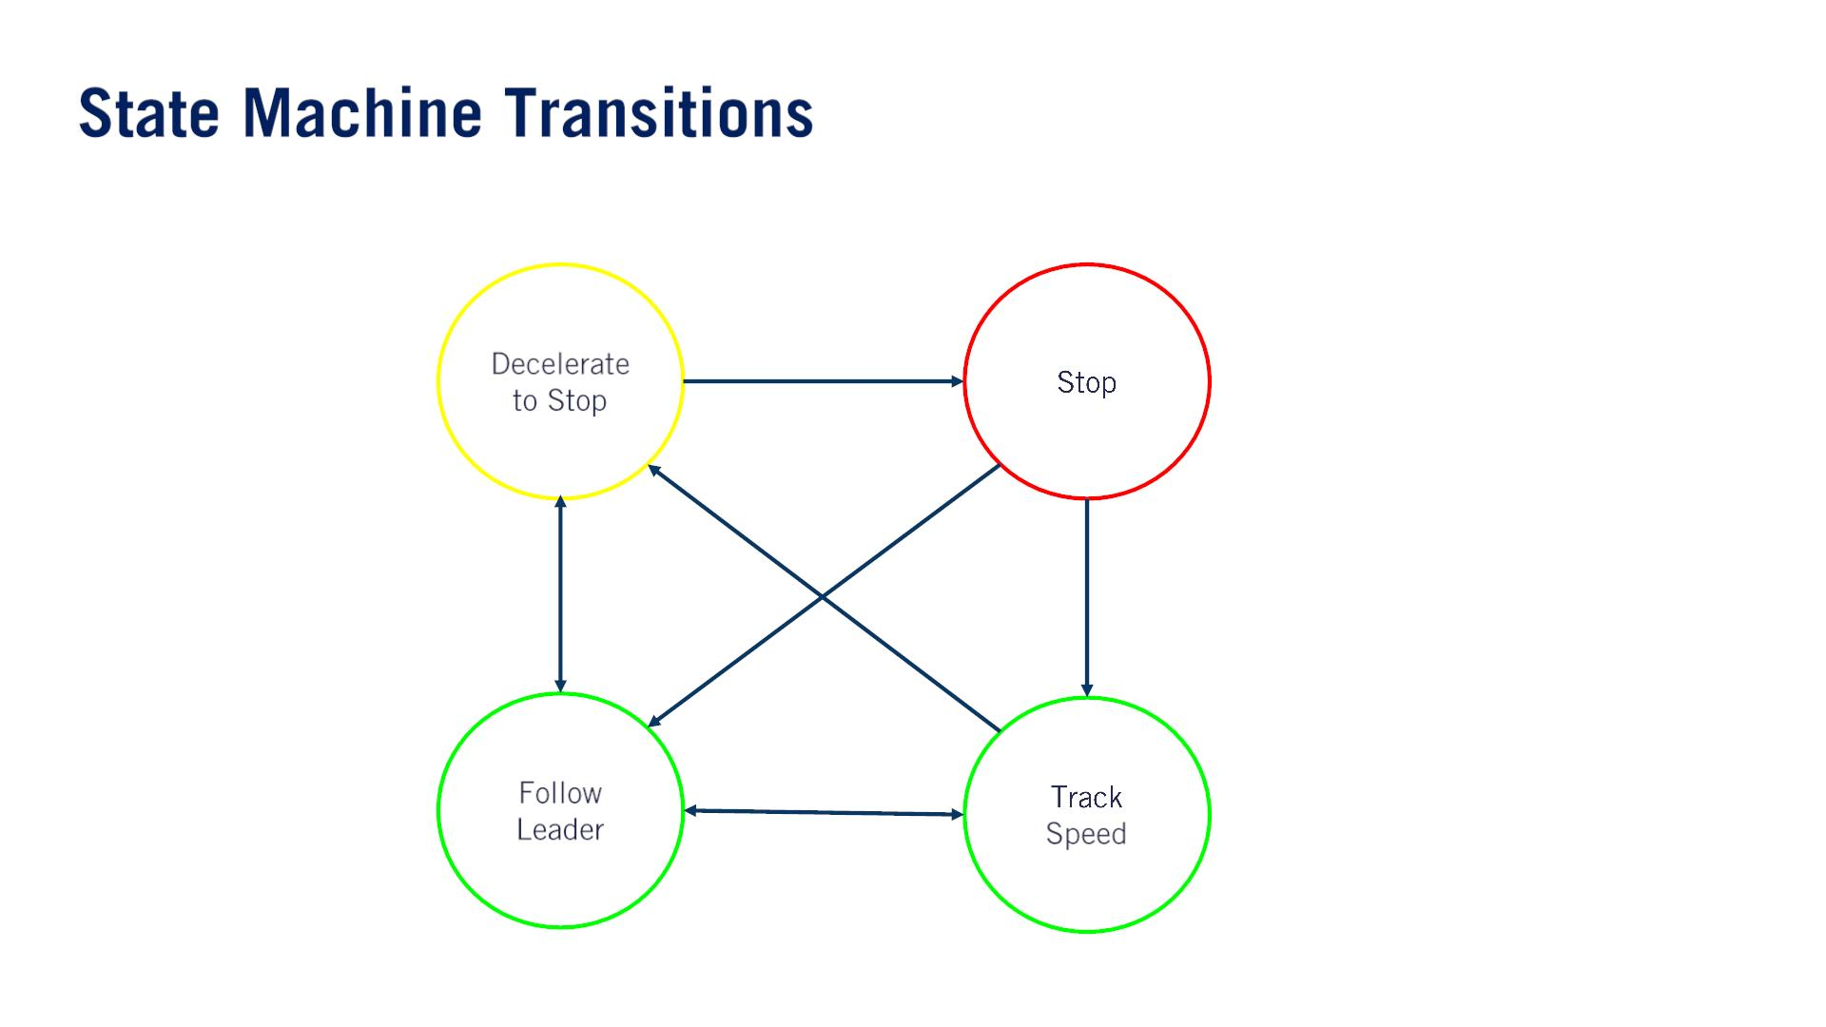

Slide 35
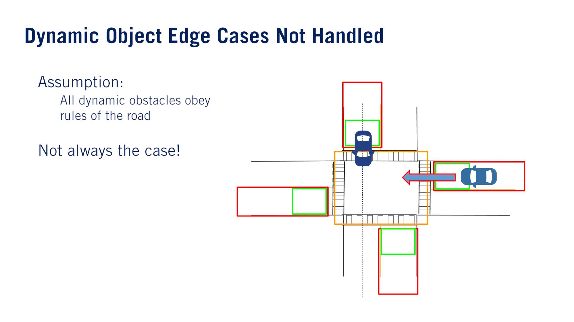
One of the primary objectives of behaviors safety assessment and testing, is to uncover as many variations of unexpected behaviors as possible, so that they also can be detected, categorized, and incorporated into the behavior planning design process.
•
•
o
例１：対向⾞が急に中央分離帯を超えて⾃⾞線に⼊った。（対向⾞は逆⾏⾞に避けたかっ た。。。）Waymo 2018, ビデオ：https://techcrunch.com/2018/05/04/waymo-van-involved-inserious-collision-in-arizona/
例２：An aggressive driver racing through an intersection even as the ego vehicle has begun driving through it.
例３：A vehicle fails to stop at the intersection.
例４：When a vehicle is parked in close proximity to the intersection. If this vehicle is not tagged as parked, so that it might be treated as a static instead of dynamic object, our behavior planner may get stuck in a deadlock state waiting for this parked vehicle to move.

Slide 36
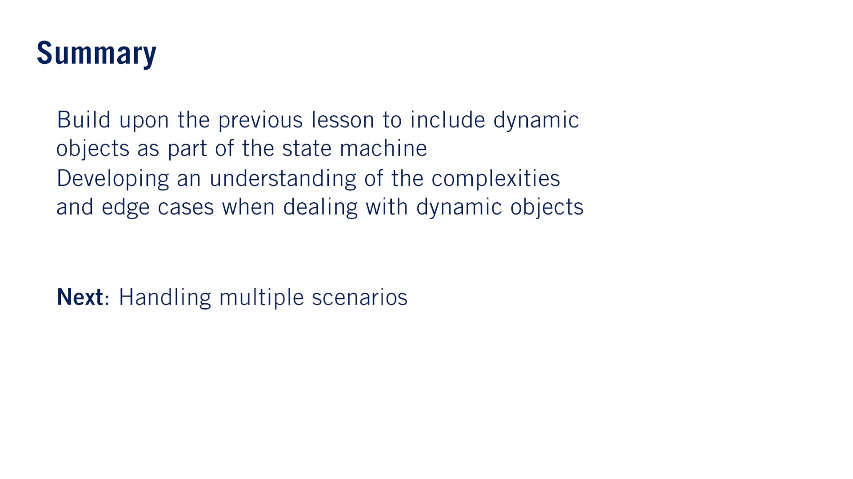
•
•
•
単語
Driveway, 私道「しどう」: A driveway is a piece of hard ground that leads from the road to the front of a house, garage, or other building.
Overtake, 追い越す: If you overtake, or overtake a vehicle or a person that is ahead of you and moving in the same direction, you pass them.
Rectilinear, 直線の、直線に進む: in, moving in, or characterized by a straight line or lines.

Slide 37


Slide 38
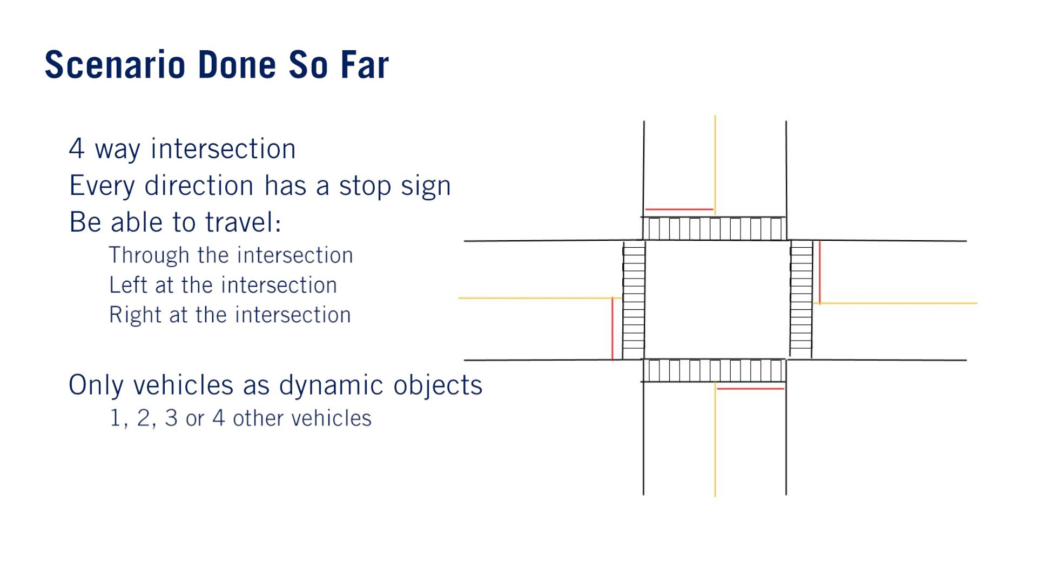
•
•
•
o
o
o
•
o

Slide 39
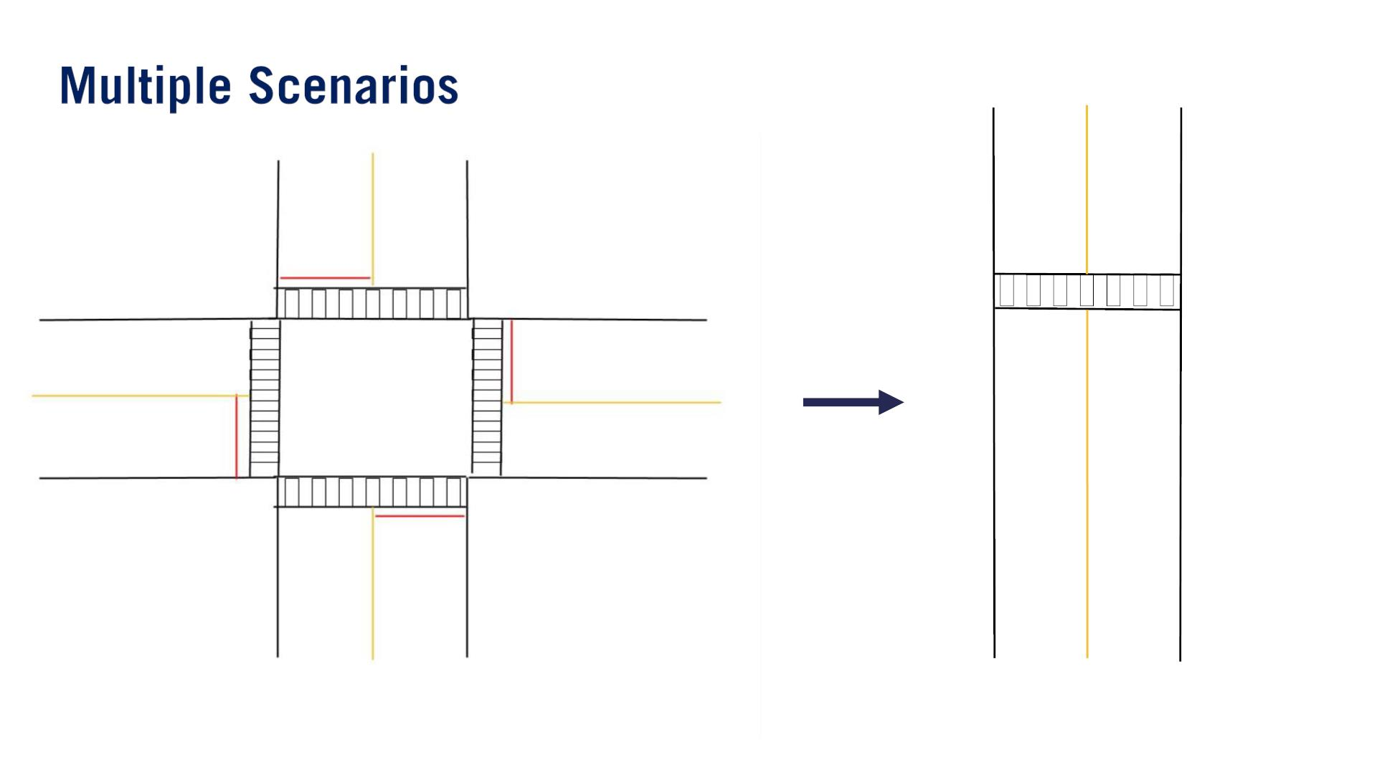

Slide 40
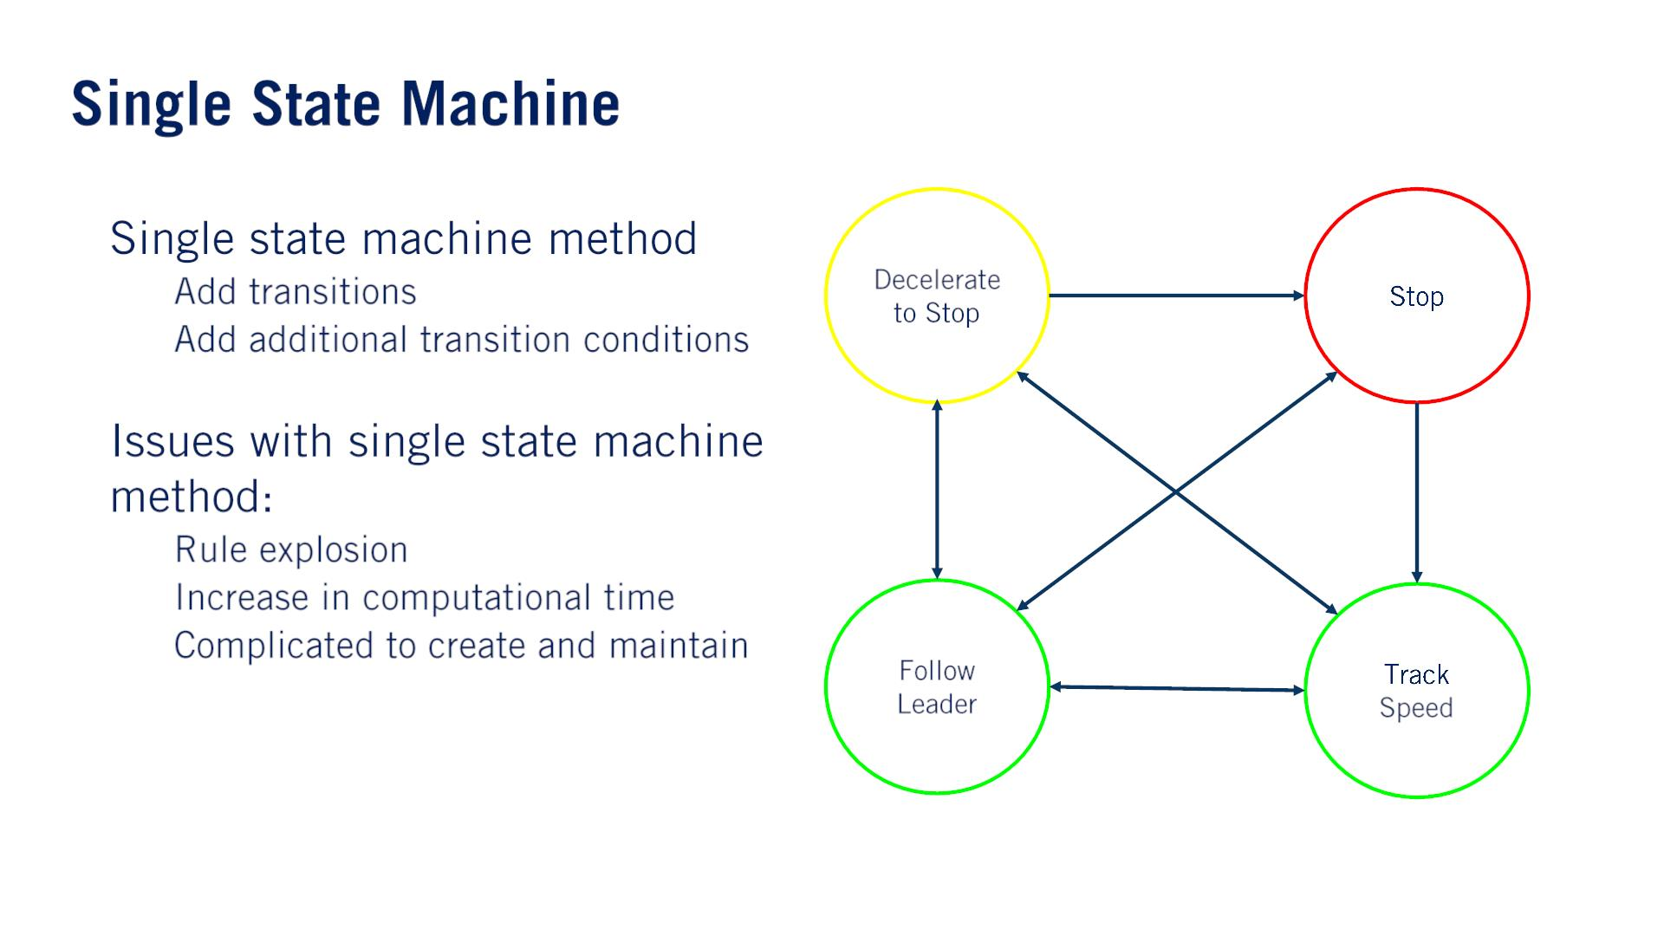
•
•
o
o
o
o
o
Essentially, as the complexity increases, we lose all the advantages of using a finite state machine.

Slide 41
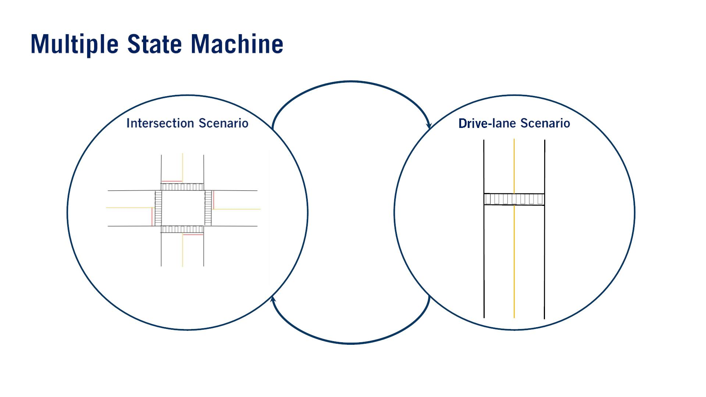
Represent each high level scenario as a single state.
Create much simpler transitions in between the high level scenario states.

Slide 42
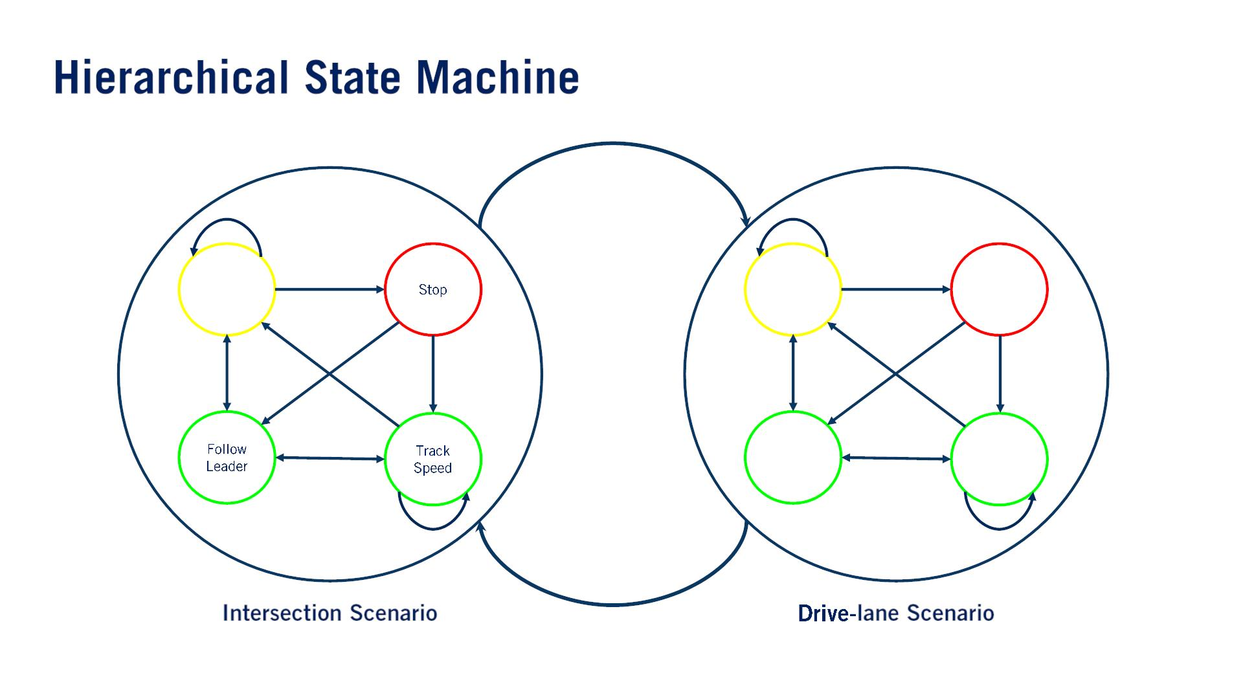
質問：how do we switch between scenarios when processing the sub-state maneuvers?
Decelerate
to Stop
Decelerate
to Stop
Stop
Follow
Leader
Track
Speed

Slide 43
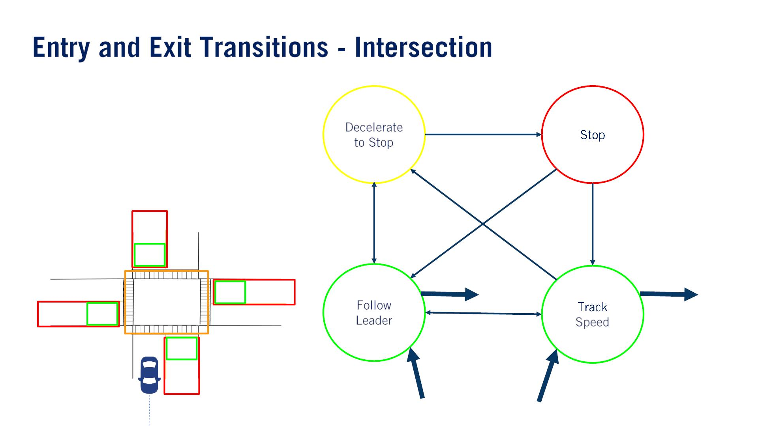
With this method of transition, able to also maintain maneuvers between scenario switches.
In this case, Track Speed in the intersection super-state will connect to the Track Speed of the next scenario that we enter.（⼤事）
introduce transitions to key maneuver sub-states out of the current scenario super-state.
例えばIntersection.
まずkey exit stateを決める。
The only way we’re able to exit an intersection is while in the Track Speed or Follow Leader states after having passed the intersection.

Slide 44
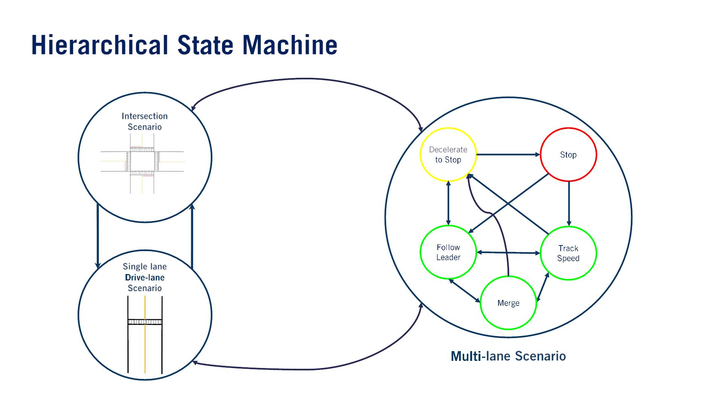

Slide 45
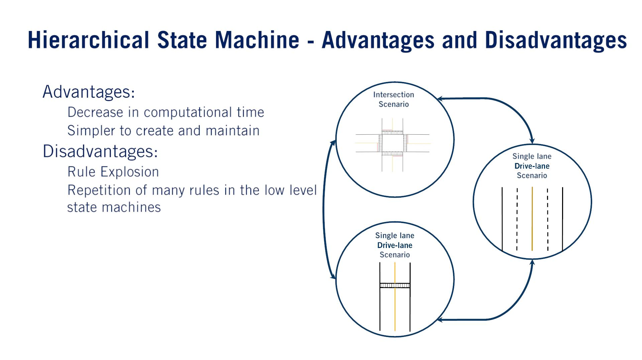
•
•
o
o
o
o

Slide 46
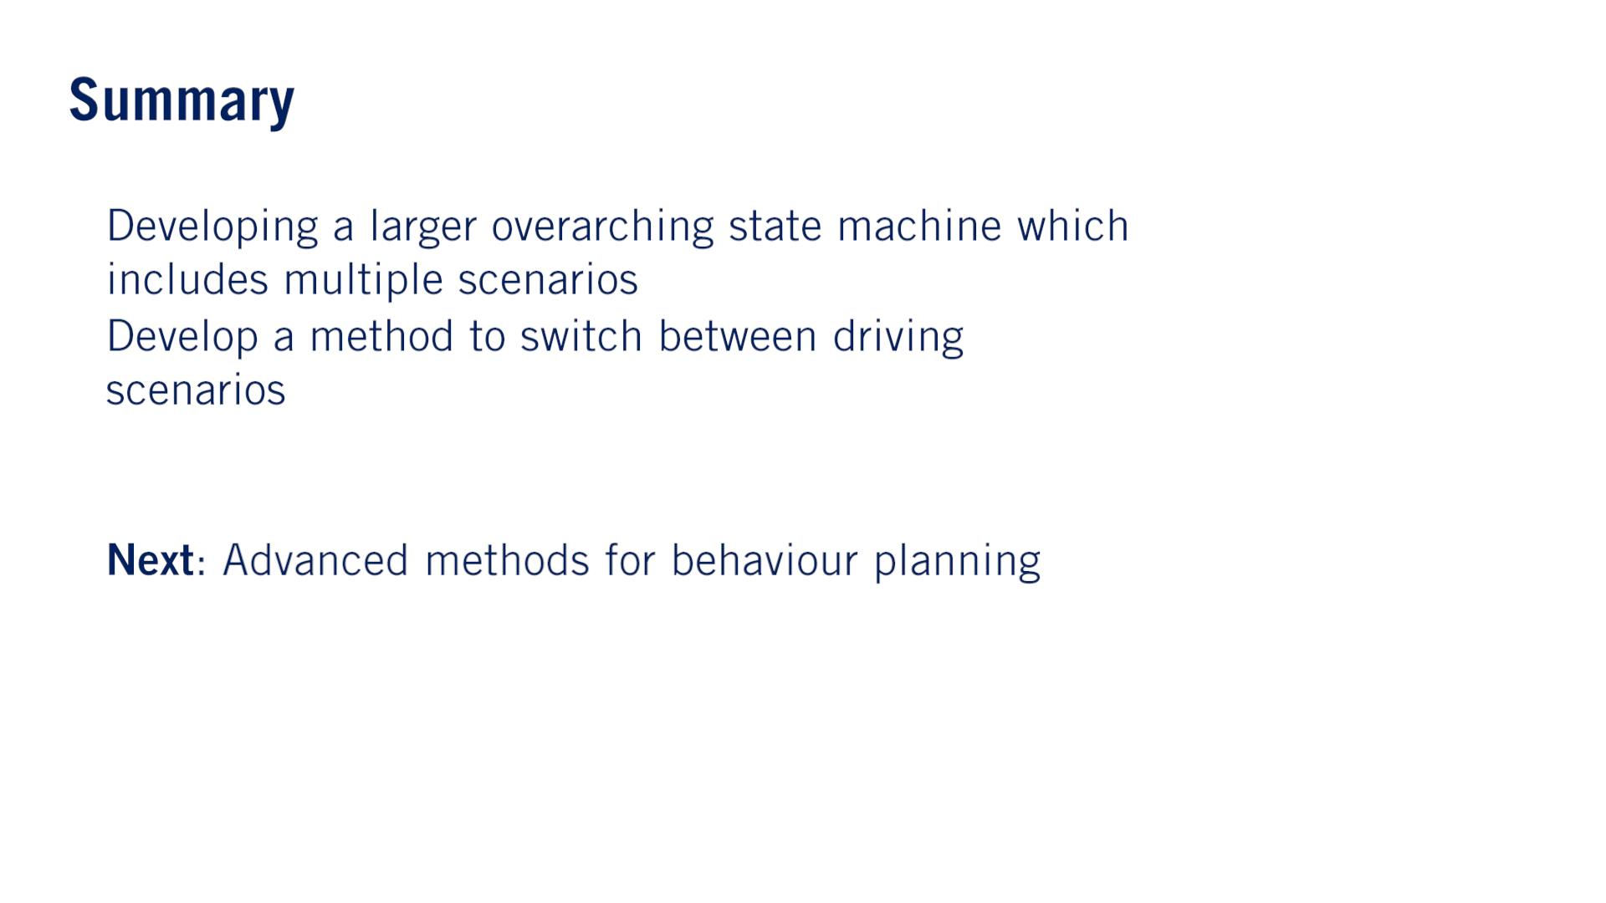
•
•
•
単語
- Overarching, 包括的「ほうかつ」: You use overarching to indicate that you are talking about something that includes or affects everything or everyone.

Slide 47

Advanced Methods for Behavior Planning

Slide 48
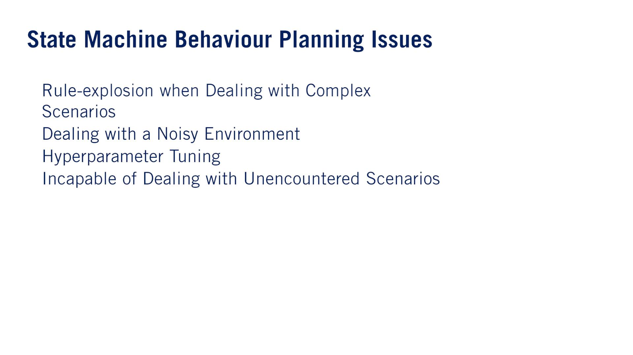
（⼤事）
•
Developing a full level 4 or 5 capable vehicle is almost impossible with finite state machines.
•
•
•
Due to the program nature of this approach it is very likely that there will arise a situation in which the programmed logic of the system will react in an incorrect or unintended manner.
State machine based approaches are classified as experts systems（エキスパートシステム）, systems which have been designed and developed by human experts.

Slide 49
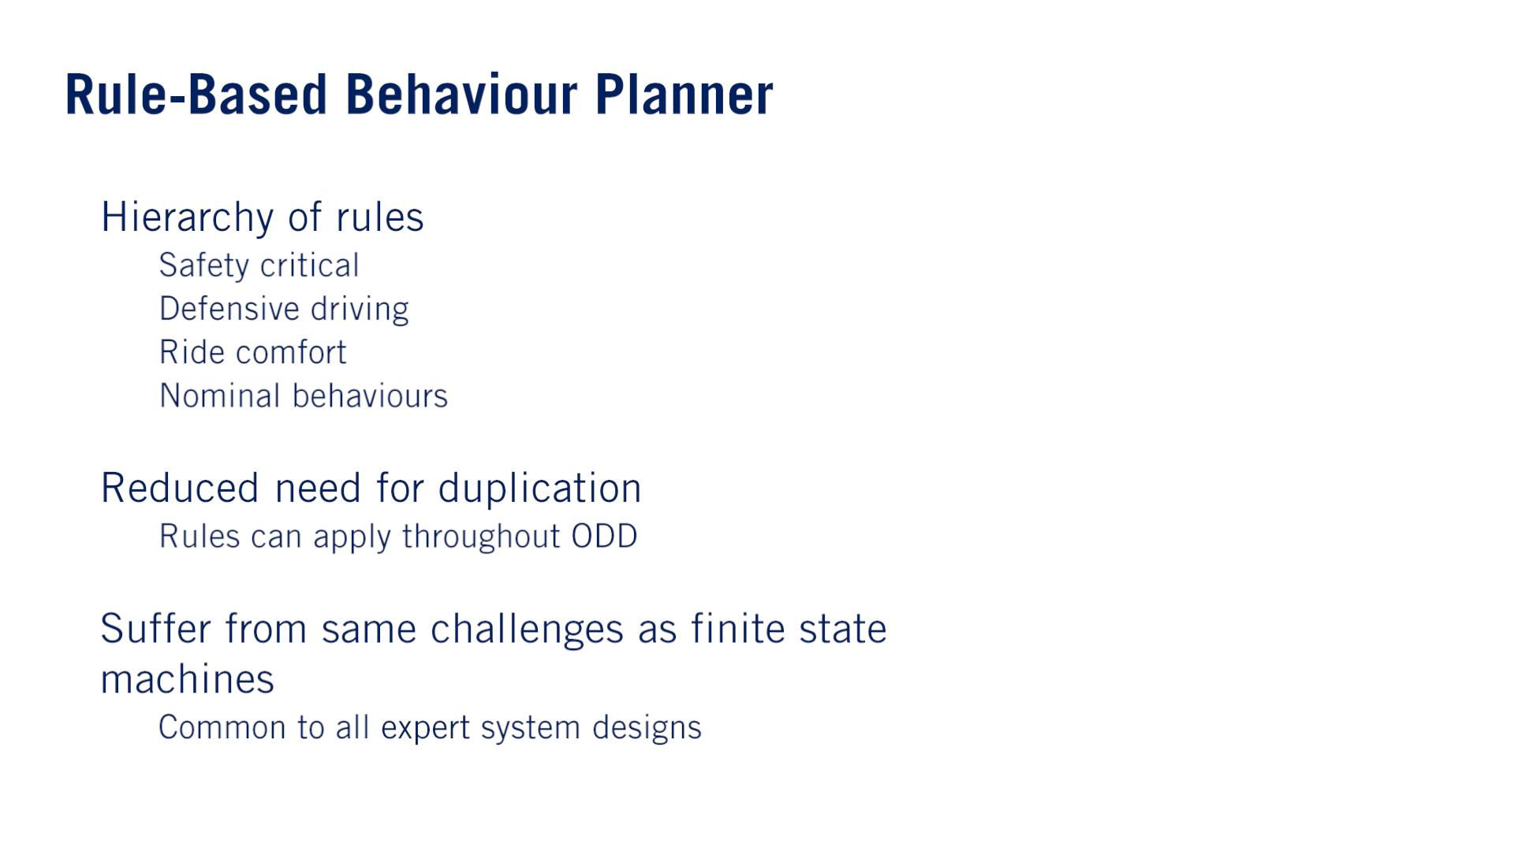
•
o
o
o
o
防御「ぼうぎょ」的
Rule based systems have to very carefully develop rules in such a way that they do not negatively impact each other, or lead to unintended outcomes when multiple rules are activated at the same time.
•
•
o
o

Slide 50
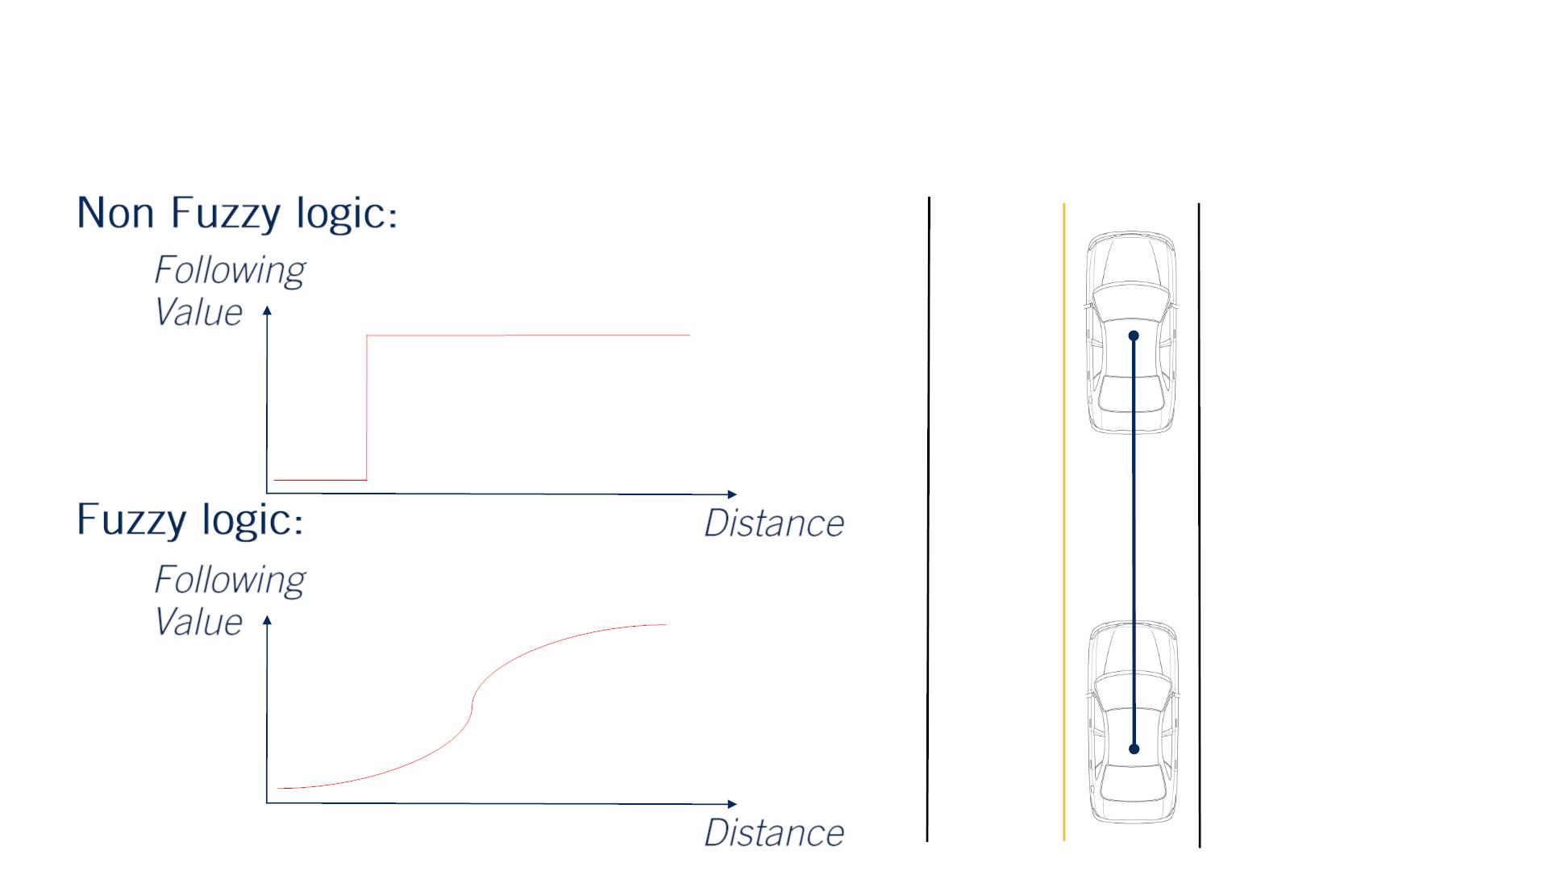
例：vehicle following behavior.
While previously we set a parametrized distance which divided the space into “Follow the Vehicle” or “Do not Follow the Vehicle”.
With a Fuzzy system we’re able to have a continuous space over which different rules can be applied.
Fuzzy: （輪郭・境界・音・思考などが）不明瞭な、不鮮明な、ぼやけた、曖昧な、はっきりしない
ファジィ論理
Fuzzy systemの課題：While Fuzzy based rule systems are able to deal with the environmental noise of a system to a great degree than traditional discreet systems, both rule-explosion and hyperparameter tuning remain issues with Fuzzy systems.
In fact, Fuzzy systems can result in rule-explosion to an even greater degree, as even more logic is required to handle the fuzzy set of inputs.
Fuzzy Logic

Slide 51
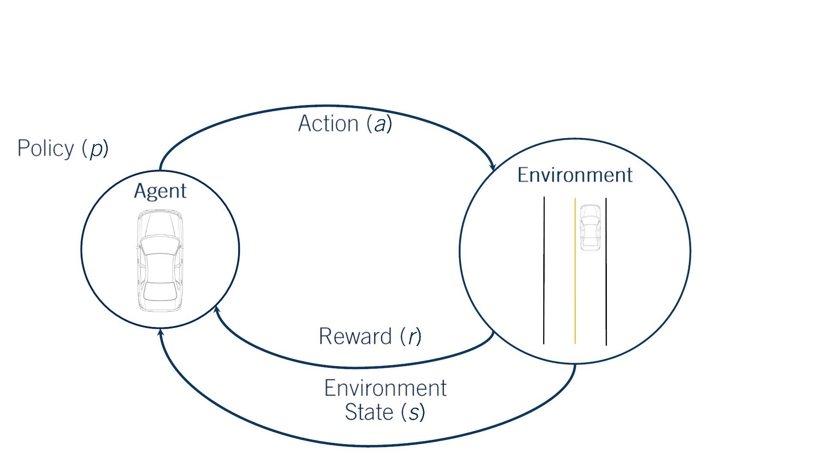
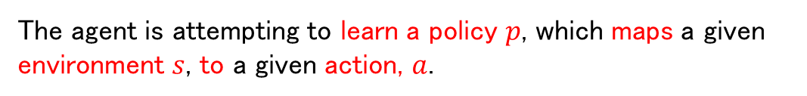
By learning in a simulated environment, no real world repercussions（反響） occurred during the many failures experienced during learning.
例：vehicle following.
Our actions may be explicitly defined as behaviors to execute, or can define behaviors implicitly through selection of desired accelerations and turn rates.
The environment can be represented by a continuous set of variables telling us relevant information, such as distance to all objects and the mission path.
Reinforcement Learning
（⼤事）
The agent is attempting to learn a policy $p$, which maps a given environment $s$, to a given action, $a$.
The reward function could be based on an optimal following distance.
Give the highest reward at the preferred distance, penalizing getting too close more heavily than being too far away.
Because of the extremely large variety of scenarios and inputs that an autonomous vehicle can encounter, direct reinforcement learning for behavior planning is unlikely to succeed.

Slide 52
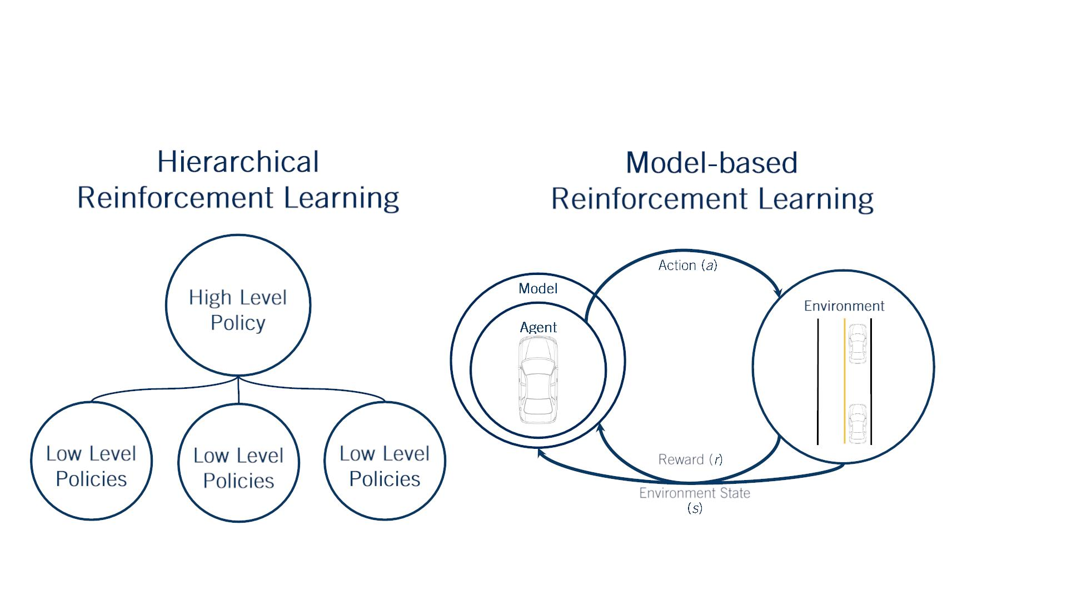
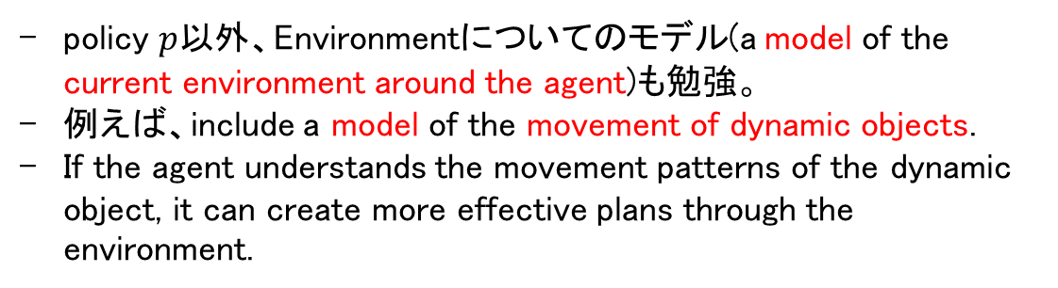
policy $p$以外、Environmentについてのモデル(a model of the current environment around the agent)も勉強。
例えば、include a model of the movement of dynamic objects.
If the agent understands the movement patterns of the dynamic object, it can create more effective plans through the environment.
Reinforcement Learning
Divide the problem into low level policies in the maneuver space and high level policies the scenarios.
Similar to the hierarchical finite state machine.

Slide 53
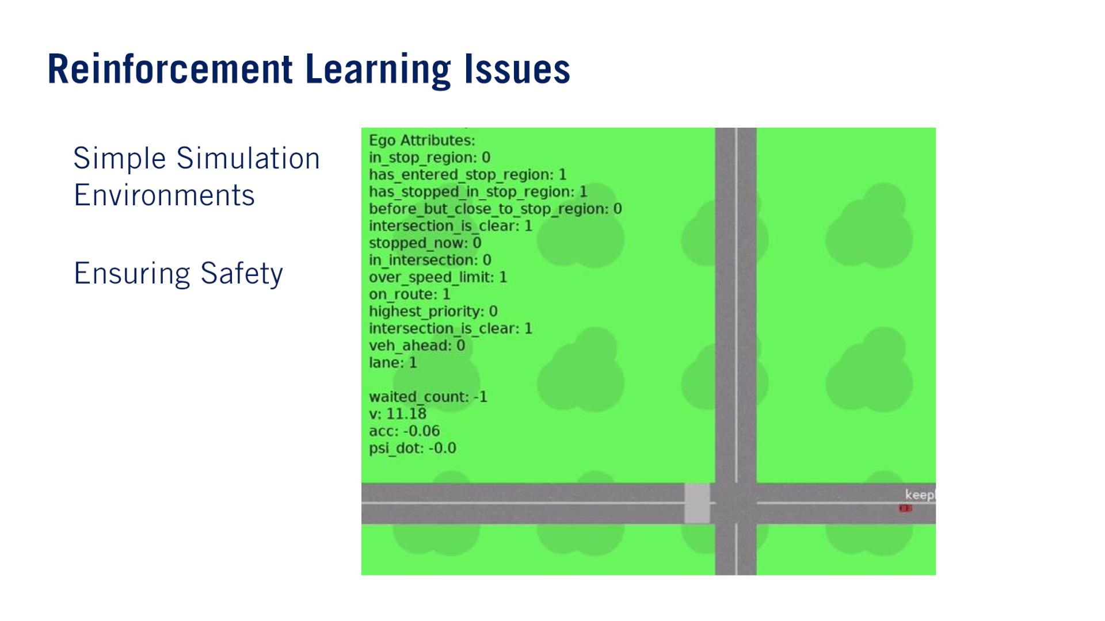
And due to their simplicity, the policies learned may not be transferable to real world environments.
Overly realistic simulators lead to the issue of severe computational requirements.
Many simulation environments used to learn the policies required for autonomous driving are overly simplified.
•
•
While there are techniques within reinforcement learning that attempt to ensure safety constraints along the trajectories created by the reinforcement learner.
There is still no way to perform rigorous safety assessment of a learned system, as they are mostly black boxes in terms of the way in which decisions are made.

Slide 54

Many of them try to learn from human driving actions.
Input: raw sensor data.
Output: throttle, brake, and steering commands.
By learning from human driving commands in an imitation learning approach.
Rather than trying to obtain a policy given a reward function, the approach is to use human driving data as the policy, and attempt to learn the reward function（報酬関数） used by humans.
https://images.nvidia.com/content/tegra/automotive/images/2016/solutions/pdf/end-to-end-dl-using-px.pdf
Observation
Agent
Environment
Reward (r)
Environment State
(s)
Once the reward function is learned, the algorithm can then execute driving maneuvers similarly to a human driver.

Slide 55

•
•
•
Behavior Planning remains one of the toughest bottlenecks in achieving real world level 5 autonomy.

